Slide 1

National Authorities for Apprenticeships:
Introduction of
Elements of the Dual VET in the Slovak Republic
Project overview

Slide 2
Project background – Flagship project of the Danube Strategy
Cooperation of the Priority Areas 7 and 8
June 2014 – visit of Minister Peter Friedrich in Slovakia – Memorandum on cooperation in the field of introduction of Dual Education
Cooperation with Austria: Memorandum of Understanding (MESR + WKO)
Project submission:
June 2014 – Erasmus+Programme – Call for proposals EACEA 13/2014“ National Authorities for Apprenticeships“
October 2014 – Notification letter from the Education, Audiovisual and Culture Executive Agency of the EC

Slide 3
Project Partners:
PP 1 | Ministry of Education, Science, Research and Sport of the Slovak Republic | SK
PP 2 | State Institute of VET | SK
PP 3 | Ministry of Finance and Economics Baden-Württemberg | DE
PP 4 | Landesakademie für Fortbildung und Personalentwicklung | DE
PP 5 | Wirtschftskammer Österreich | AT
PP 6 | German-Slovak Chamber of Industry and Commerce | SK
PP 7 | Bundesinstitut für Berufsbildung | DE
Associated Partners:
AP 1 | Volkswagen Slovakia, a.s. | SK
AP 2 | Bundesministerium fur Wissenschaft, Forschung und Wirtschaft | AT
Budget:
Total costs: 312 717,41 €
EU grant: 234 538,06 €
Cofinancing: 78 179,35 €

Slide 4
Unemployment rate of under 25 years old
(2013, EU – 28 countries, Eurostat)

Slide 5
Lessons learned from the first initiatives of apprenticeship schemes started in Slovakia in cooperation with German and Austrian partners:
the need to motivate Slovak companies to invest in human resources and to become active in apprenticeship schemes,
the uncertainty regarding the regulatory framework for apprenticeship models,
the lack of adequately qualified teachers and in-company trainer,
low social reputation of TVET careers.
These key challenges should be addressed by the our project, while our ambition is to transfer good practice to other countries of the Danube region which are facing the same problems as Slovakia

Slide 6
Aims and objectives
Promote a national VET system reform
Set-up of a competence center for dual VET (Danube Academy)
Mobilize SMEs and companies for dual apprenticeships
Implement an experience exchange for apprenticeships

Slide 7
1. Policy and decision makers, public authorities at national level
2. Chambers/associations and human resource development personnel in SMEs
3. VET students, VET providers, teachers and in-company trainers
4. Social Partners, public employment services and other VET stakeholders
Target groups

Slide 8
Expected impact
Fostering the national VET system reform
Establishment of a Competence Centre for dual VET (Danube Academy)
A stronger and sustainable mobilisation of SMEs and companies for dual apprenticeships
An ongoing experience exchange for apprenticeships

Slide 9
Work packages and WP leaders
The project is structured in 6 work packages:
WP 1 | Project Management | PP 1
WP 2 | Quality Monitoring | PP 4
WP 3 | Identification of labour market needs for technical apprenticeships in the Slovak Republic | PP 6
WP 4 | Development and implementation of dual technical apprenticeships in the Slovak Republic | PP 1
WP 5 | Dissemination | PP 2
WP 6 | Exploitation and sustainability | PP 3

Slide 10
The project is based on the following milestones:
M 1 | The analysis and a result report based on the analysis of the labour market needs | WP 3
M 2 | The analysis and review of new Slovakian TVET law and implications for technical apprenticeships as well as the analysis and review of Slovak VET pilot schemes including recommendations | WP 4
M 3 | An action plan to setup a Danube Academy for Dual Education for technical apprenticeships in Slovak Republic as a centre of excellence and to mobilise the industry | WP 4
M 4 | A training concept and pilot trainings of TVET personnel such as teachers and instructors | WP 4
M 5 | The development of a Community of Practice for apprenticeships to gain a sustainable exchange of experience | WP 4

Slide 11
Time plan
Project Duration 1.10. 2014 – 30.9.2016
 | 2014 |  |  | 2015 |  |  |  |  |  |  |  |  |  |  |  | 2016
 | 10 | 11 | 12 | 1 | 2 | 3 | 4 | 5 | 6 | 7 | 8 | 9 | 10 | 11 | 12 | 1 | 2 | 3 | 4 | 5 | 6 | 7 | 8 | 9
WP 1
WP 2
WP 3
WP 4
WP 5
WP 6

Slide 12
Survey Data
Identification of Labour Market Needs for Vocational
Education and Training (VET) in the Slovak Republic
Work Package 3
Target: 72 industrial companies (technical focus)
Period: February/March 2015
Prioritization of professions and supporting
the reform of the Slovak VET system

Slide 13
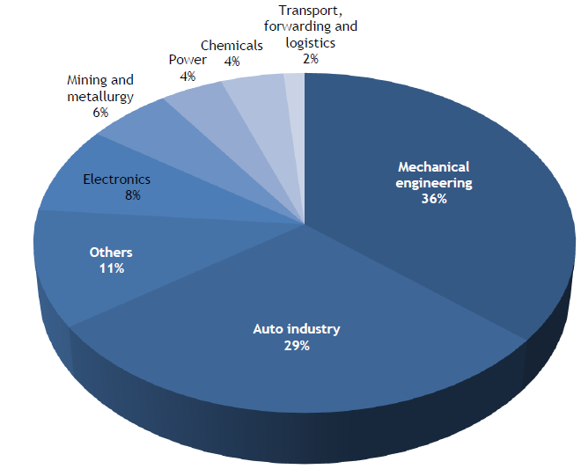
Basic company details
Companies by sectors

Slide 14
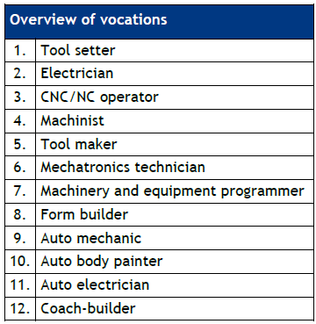
Labour force education and composition
Ranking of the most in-demand vocations

Slide 15
Concept of the Danube Academy for Dual Education
The main aim of the Danube Academy (DA) should be education of teachers of technical subjects – focus on the 7 professions resulting from the survey made by DSIHK and
virtual network of competence centers and relevant training programmes for teachers of the Danube countries
qualification center for teachers
consultations to companies and schools
help to prepare study programs based on experience of DSIHK and WKO
networking of the schools and companies
one or more pilot schools - to transfer their practice all over the country or even in the other countries of the Danube region
information platform of chambers
life-long learning of teachers, instructors and teachers for training (to teach new applications) in order to secure the competiveness of the companies
organize best practice exchange within the Danube region – also through mobility of teachers for training, instructors, teachers and students

Slide 16

Thank you for your attention!

