Slide 1

GeoNetSee
An AI/IoT-based system of GEOsensor NETworks for real-time monitoring of unStablE tErrain and artificial structures
29th PA7 Steering Group Meeting
Bratislava, Slovakia, 6th of June, 2025
Kruna Ratković

Slide 2

GeoNetSee
SO #3
Cross-border pilot implementations
SO #1
Capacity building actions & Danube Collaborative Center (DCC) creation
Specific Objectives
GeoNetSee project aims to create an integrated geosensor network and digital platform (DCC) to monitor displacements and deformations of terrain and artificial structures in the Danube region, enabling real-time data sharing and improving risk management.
SO #2
Development of GeoNetSee system for geodetic monitoring

Slide 3
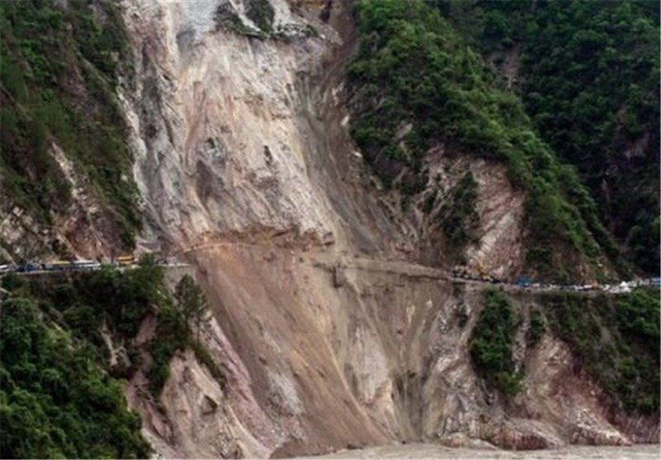
GeoNetSee objectives
Reduce the innovation gap (AI, GNSS, IoT uptake in risk monitoring) in the Danube region;
Deploy geosensor systems in 3 pilot countries (Serbia, Montenegro, Bosnia & Herzegovina);
Establish Danube Collaborative Center (DCC):
→ Central data & knowledge hub
→ Cross-border integration
→ Long-term sustainability.

Slide 4
GeoNetSee
numbers
Project budget: 1.791.280 EUR
Interreg funding: 1.433.024 EUR
Project duration: January 2024 – June 2026
Lead partner: School of Electrical Engineering, University of Belgrade
14 Project Partners + 12 Associate Partners across 9 Danube countries

Slide 5
GeoNetSee relevance
Geohazards represent a growing threat
Climate change, tectonics, and aging infrastructure increasing risks
Landslides & slope failures disrupt transport, safety, tourism, and economy
Fragmented national systems call for transnational coordination
GeoNetSee responds through:
Application of cutting edge AI/IoT technologies;
Real-time system of geosensors with the early warning functionality;
Enabling transnational collaboration via the DCC.

Slide 6
GeoNetSee
PA Alignment
PA7 – Knowledge Society
        Strengthening advanced Research & Innovation infrastructure
        Enabling cross-border knowledge exchange and collaboration
PA5 – Environmental Risks
Providing real-time geohazard monitoring for disaster risk reduction
PA1B – Mobility
Enhancing safety through continuous monitoring of critical transport infrastructure
PA8 & PA10
Fostering clustering of innovation actors and smart specialization synergies
Supporting strategic multi-level governance via the DCC

Slide 7
GeoNetSee
Innovation
Based on GNSS sensors & AI for real-time landslide detection and terrain monitoring
  Predictive analytics using AI algorithms to anticipate ground movement and structural risk
Integrated with EPOS to support pan-European geodynamic observation
Pilot actions at 9 locations: 3 main & 6 mini sites monitoring both natural and built environments
Built upon expertise from past EU projects: GIMS, GeoTwinn, safEarth, RESPONSa

Slide 8
GeoNetSee
Impact
Strategy on Reducing the Innovation Gap in the Danube Region:
Cross-country mapping of innovation ecosystems
Identification of bottlenecks & funding paths
Expected Impact:
Stronger policy alignment
Uptake of geodetic monitoring solutions
Better cross-border response
Resilience for infrastructure and citizens

Slide 9
GeoNetSee
beyond borders
☑️ Transnational & Scalable
Works across borders, replicable in other macro-regions
☑️ Technological Pioneer
AI & IoT for GNSS-based terrain monitoring
☑️ Institutional Legacy
DCC platform & CORS networks continue after project end
☑️ Policy Uptake
Data feeds disaster risk strategies and smart infrastructure planning

Slide 10
GeoNetSee is more than a project, it bridges science and action, shaping a smarter, safer, and more resilient Danube Region.

Slide 11
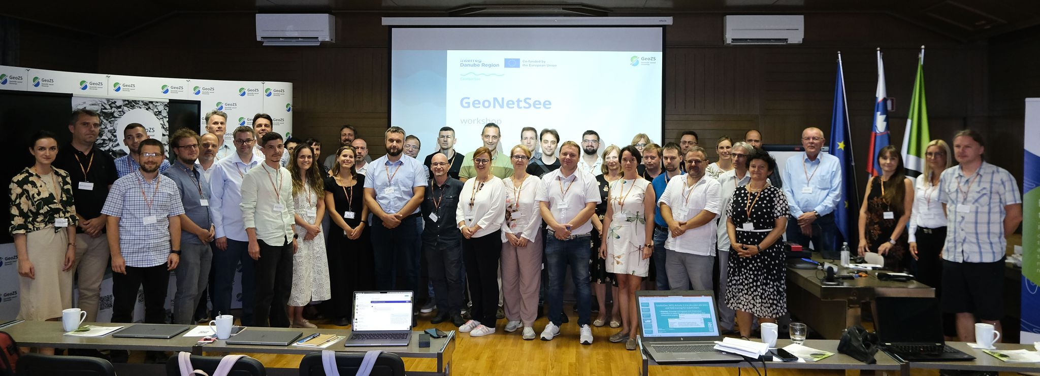
Contact
Information
Prof. dr Vladimir Rajović
Project Leader
University of Belgrade
School of Electrical Engineering, Serbia
rajo@etf.rs

