Slide 1

transformative innovation for climate change adaptation in the danube region
Project Pitch
EUSDR PA7 SG Meeting | 06 June 2025

Slide 2

















Partners
Consortium
Burgas
Municipality
EDC Debrecen
Maribor
Suceava
Municipality
Implementing & Cross-Border Partners
Volume: €4 Mio
Duration: 01.06.2025-31.05.2028
Nord-Est
District Burgas
Hajdú-Bihar County Government
Odessa Regional State Administration
Kirklareli Province

Slide 3
Project Overview and Roles
TiCCA4Danu proposes a novel and comprehensive transformative innovation framework to accelerate just climate change adaptation (CCA) at the level of cities and their surrounding administrative regions. In order to address the structural barriers for CCA implementation at the city-region level, TiCCA4Danu proposes a systems-level approach, which requires effective governance changes, introduction of directionality, and a different use of policy instruments favouring discovery and experimentation processes.
Objectives:
SO1: Co-develop and operationalise knowledge for CCA implementation with public authorities and local researchers.
SO2: Empower public authorities in the Danube Macro-Region to implement available CCA solutions with a ready to use comprehensive framework for transformative innovation policy at the city-region level.
SO3: Further develop existing approaches for citizen engagement, in particular, vulnerable groups, and contribute to the research on barriers to and triggers for behavioural change from citizens and economic sectors.
SO4: Strengthen the involvement of the private sector, including banks and investors to facilitate the CCA economy and bridge the financing and investment gap.
SO5: Facilitate knowledge transfer into neighbouring Danube countries by establishing work relations with the EUSDR.
SO6: Facilitate transdisciplinary collaboration and advance the literature and policy debates on mission-oriented TIP for climate-just CCA implementation.

Slide 4
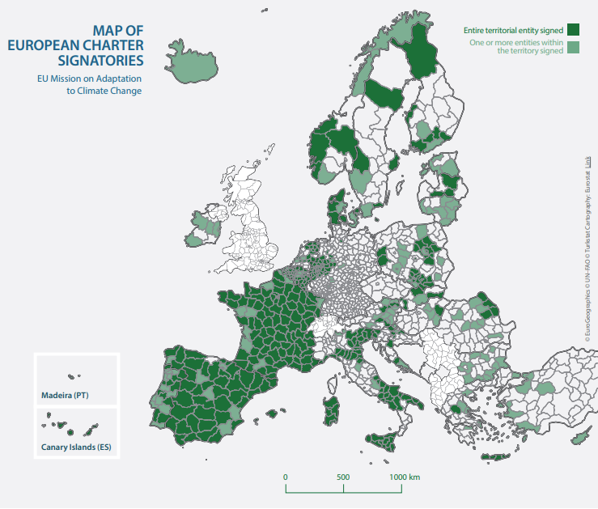

TiCCA4Danu addresses:
Different bio-geographical regions
in the Danube Macro-Region (EUSDR)
at the City-Region level (4 Anchor Cities + their surrounding regions + cross-border partners)

Slide 5
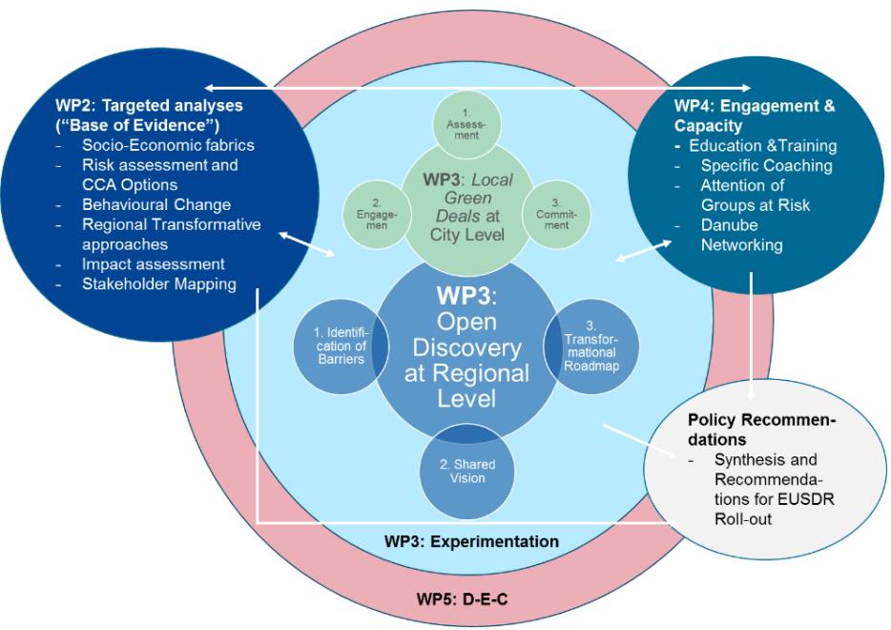
Four interlinked building blocks:
Analysis (WP2)
Experimentation (WP3)
Engagement & Capacity (WP4) and
Policy Recommendations (WP3/WP4)
working in feedback loops to ensure science-based, inclusive, and actionable climate adaptation across city-regions.

Slide 6
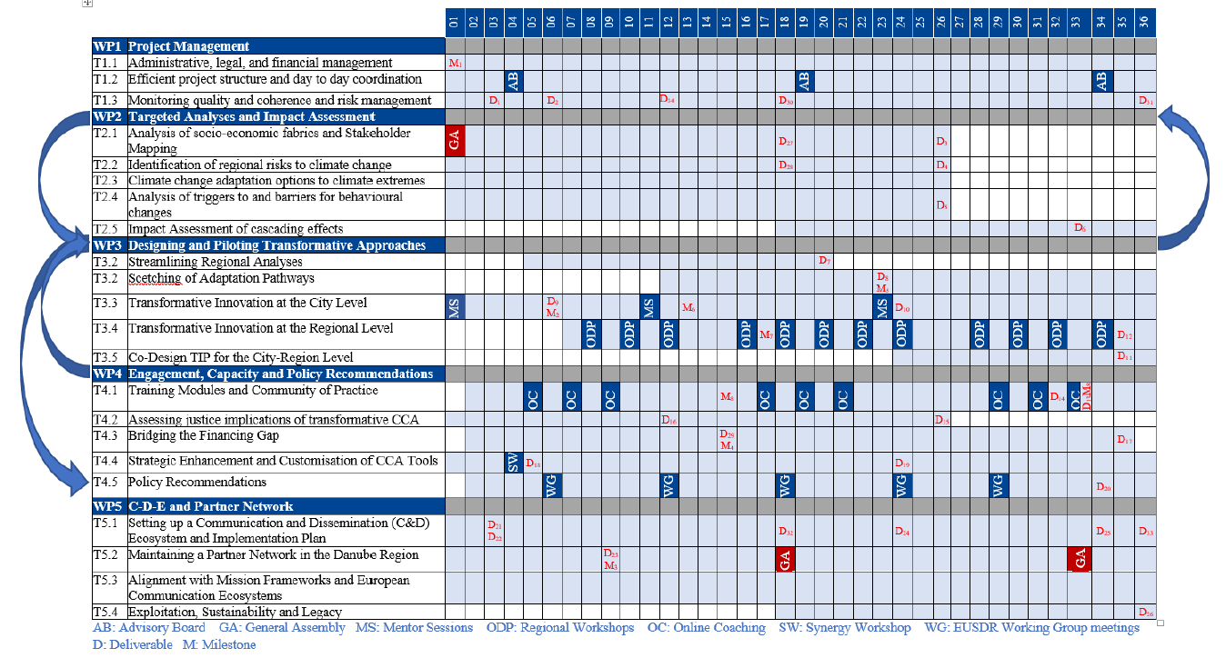
WP1: Project Management

Slide 7
WP5: D-E-C and Network Maintenance
Task 5.2: Maintaining a Partner Network in the Danube Region
Target: get EUSDR Flagship status
Collaboration with the Working Groups under Pas „Knowledge Society“ (e.g. WG RIS3), „Protecting the Environment“ and/or „Building Prosperity“ – participation at the meetings to facilitate dissemination and identify potential for scale up.
Danube-region wide „Peer Learning online Exchanges“ (2 hrs) with partner cities/regions and Danube stakeholders to be organised annually.
Organisation of the 2nd GA and mid-term dissemination conference back-to-back to the EUSDR Annual Forum in Sofia, Bulgaria (fall 2026) (optional: workshop on Transformative Innovation Policy)

Slide 8
WP5: D-E-C and Network Maintenance
Task 5.3: Alignment with Mission Frameworks and European Communication Ecosystems
Engagement with established platforms (with priority MIP4Adapt portal, Climate-ADAPT, Futurium, WeAdapt, New European Bauhaus, JustREACH „sister“ project, JRC, S3 CoP, Interreg Europe Platform, etc.)
Deliver them regularly content about TiCCA4DANU
Participate in and contribute to their events (with presentations of TiCCA4DANU activities)
Bring in experts from this broader community to our (EUSDR) events
Organise bilateral meetings with these initiatives

Slide 9
THANK YOU oliver.Ziegler@vdivde-it.de

