Slide 1
EU Commission and DG REGIO updates
Steering group meeting of the Priority Area 7 Knowledge Society
Elisa COCCO
Elisa.cocco@ec.europa.eu
DG REGIO

Slide 2
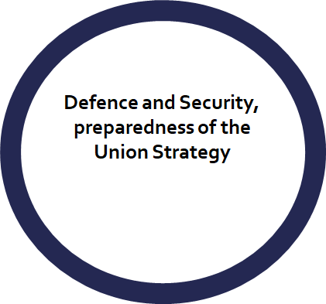





POLITICAL GUIDELINES FOR THE CURRENT EUROPEAN COMMISSION 2024−2029
A global Europe:
Enlargement and relations to neighbourhood
Europe’s sustainable prosperity and competitiveness
Supporting the citizens,
Supporting Young people of the European Union

Slide 3



5th Commission Report on Implementation
of EU Macro-regional Strategies
Where do we stand?
    The report was published on 13 May 2025 and presented at the REGI committee of the Parliament on the same day;
    Opinion of the Council of European Union with the Polish presidency is expected before end of June.
The report highlights:
    Implementation and the action plans;
    The support to Ukraine;
    MRS and Youth;
    The support to the Commission’s priorities: digital, green and fair transition, enlargement.

Slide 4

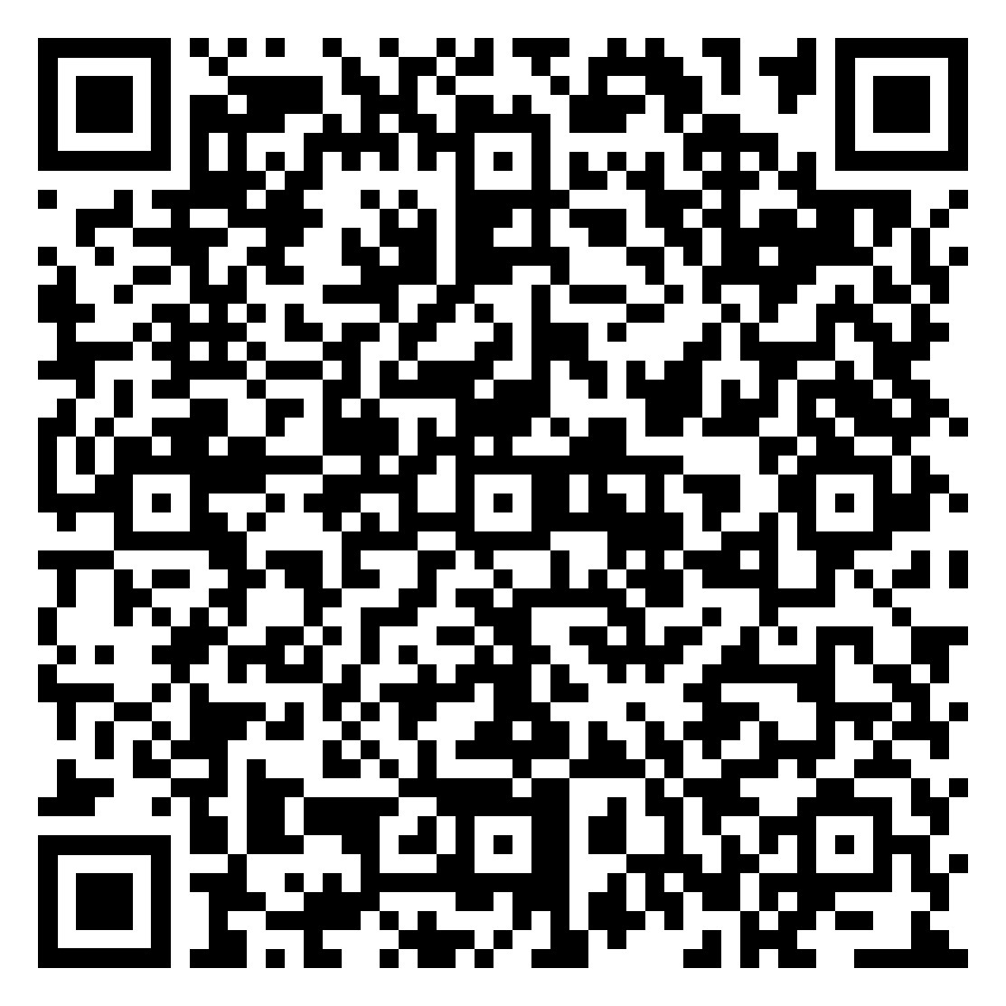
Youth for Future Cooperation
Youth consulted on the future of cooperation:
What does the young generation expect from EU and cooperation?
The declaration by young people on the future of territorial cooperation
Seven recommendations with concrete actions to be taken into consideration for the future:
Reinforce capacity building through Interreg and Macro-regional Strategies for applicants, stakeholders – create tailored calls for capacity building;
More small scale projects (max EUR 50 000) – 100% co-financing – higher pre-financing – simpler administration and shorter project duration;
More large scale infrastructure projects.
4

Slide 5
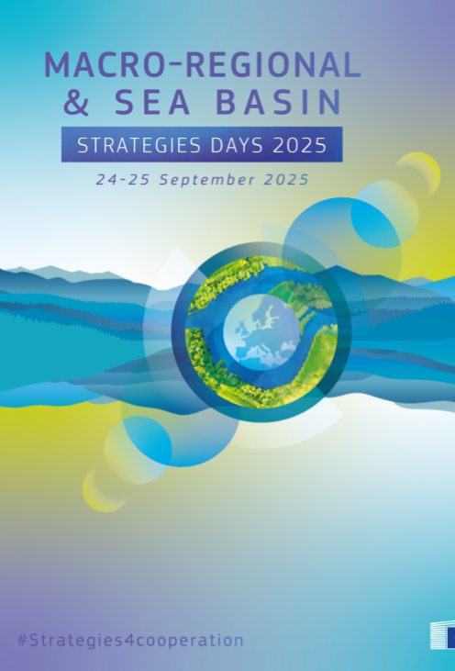
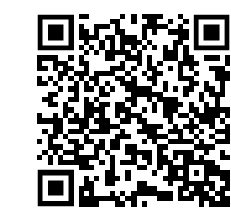
When? 24 and 25 September 2025
Where? Brussels, Area 42, Rue des Palais 46
Followed by the High level group meeting
on the Macro-regional Strategies
Friday, 26 September 2025

Slide 6
12:00- 13:30 | Start of registration and lunch
13:30 - 14:30 | High level opening of the Strategies Days 2025
14:45 - 16:30 | Workshops time (parallel workshops) Water extremes, water resilience and disasters’ risk management Energy Networks - Advancing Regional Cooperation for a Decarbonized Europe Maritime and Internal Security Enhancing cooperation between transnational programmes and Macro-regional Strategies (+ embedding) Coastal Communities and territoriality of the Strategies
16:30 - 18:00 | Speed dating with the Commission
18:00 - 20:00 | Cocktail and dinner

Slide 7
9:00 - 9:30 | Welcome coffee
9:30 - 12:30 (coffee break in between at 11:00) | Cross strategies Fertilisation session organised by the Assistant Mechanisms and Interact
12:30 - 13:30 | Lunch
13:30 - 14:40 | Synergies panel and closing of the event

