Slide 1
29th Steering Group Meeting of EUSDR Priority Area 7 06 June 2025 | Slovakia, Bratislava

Slide 2

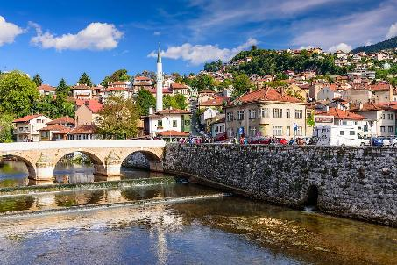
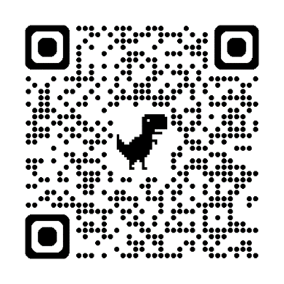
2025 EUSDR Presidency
01 01 2025 – 31 12 2025 Bosnia and Herzegovina – Flowing together, growing together
Horizontal Priorities
Speeding up the European integration process in connection with its effects on: brain-drain, widening skills gap, depopulation, youth unemployment;
Thematic priorities
Security, civil protection and disaster preparedness;
Tourism and culture;
Connectivity and green transition;
Education, skills and labour market.
Events
Notes:
Events are included on the last slide

Slide 3

DSP support frame
Support for EUSDR core-stakeholders
Embedding & Funding
Monitoring & Evaluation
Communication
Capacity Building
Youth involvement

Slide 4

Support for EUSDR core stakeholders
Support the core-governance and - management of the EUSDR
Institutional memory - documentation of meetings, revision of contact lists & common calendar
Support EUSDR-internal horizontal coordination measures and closer cooperation with further relevant stakeholders
Technical and thematic support to PAC events, SG meetings
Facilitating stronger involvement of EUSDR core-stakeholders into PA and SG activities
Cross-PA and cross-MRS events for PACs
Support for increasing visibility of PAs activities and achievements

Slide 5
EUSDR Governance Development Recap of the process 2023 – 2025
2023
January & December 2024
Joint NC-PAC Meetings
2025
August 2023
Update of NC & PAC Rules of Procedure
February 2025
2nd Governance Development TF EUSDR PAC Meeting
April 2025
3rd Governance Development TF EUSDR NC Meeting
November 2023
Governance Architecture Paper Review
1st Governance Development TF Meeting
2024
March 2025
Questionnaire among PACs for prioritisation of governance-related topics
May-June 2025
Cluster Meetings

Slide 6
EUSDR Governance Development Clusters
Cluster 1: PAC roles & responsibilities Active contribution: PA 7, PA 8, PA 9, NC AT | Cluster 2: SG roles & responsibilities Active contribution: PA 1b, PA 6, PA 7, PA 8, PA 10, NC SK
Cluster 3: relation/linkages between stakeholders Active contribution: PA 1b, PA 6, PA 9, PA 10, NC SI, NC CZ, NC RS, NC SK | Cluster 4: PACs co-chair PAC meetings/BAGL Active contribution: PA 6, PA 7, PA 9

Slide 7
Meetings of Governance Development Clusters
4 Clusters for further discussion of governance development topics as sub-groups of EUSDR Governance Development Task Force
Topics to be discussed were brought up and prioritised by EUSDR PAs, additional points from EUSDR Process Evaluation 2025
Discussion among PACs, NCs, supported by DSP and guided by the (TRIO-)PCY (participation on voluntary basis)
Discussion & elaboration of topics at EUSDR level (in a further step, can be transferred into key-documents of the Strategy, e.g. EUSDR Governance Architecture Paper, NC/PAC RoP); NOT topic of discussion: NC level, PA level and/or cross-PA level implementation, which, in a further step, can be transferred into PA RoP, working plans, roadmaps, PAC projects etc.
Proposals to be further discussed in EUSDR Governance Development TF and presented/agreed at joint NC-PAC Meeting in September 2025

Slide 8

Embedding & Funding
Facilitating close contact with Managing Authorities, European Funding instruments and other financing institutions
Meetings of MA Networks
EUSDR Embedding Weeks
Embedding support for PACs
Overviews of EUSDR-relevant EU calls
Monitoring and analysing the state of embedding
Interim and final report / analysis on embedding

Slide 9

Monitoring & Evaluation
Supporting the revision of EUSDR core-documents, EUSDR core-decision making processes and EUSDR reporting
EUSDR Implementation Report 2022–2023
Further developing and implementing an EUSDR monitoring, evaluation and data collection system
EUSDR Evaluation Plan 2023-2028
EUSDR Process/Implementation Evaluation
EUSDR Policy Evaluation (to be conducted in 2027/2028)
new
new

Slide 10
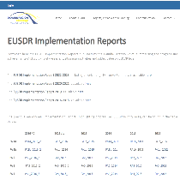
EUSDR Implementation Report 2022-2023
Developments and achievements in EUSDR Priority Areas
Main achievements and unique implementation through the EUSDR framework
Policy development
Projects and processes – implementation & funding
Implementation and activities across PAs
Capitalisation of projects and activities
Steering Groups
Cooperation with stakeholders
Strategic policy development
EUSDR horizontal activities and priorities
E.g. EUSDR governance meetings, core documents, Monitoring & Evaluation, Embedding, Communication, Capacity Building, Youth involvement
Now available on the EUSDR website (→ key documents)
Thank you for the input provided via the PAC Reporting tool in spring 2024!

Slide 11
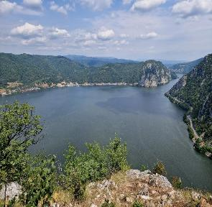
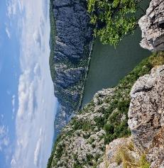
EUSDR Implementation Report 2022-2023
Main Conclusions and Lessons Learned in 2022-2023
Setting clear, realistic objectives leads to effective outcomes
Regular communication with stakeholders maintains engagement and participation
Involving new stakeholders, particularly youth, strengthens political commitment and national support
Hybrid meeting formats increase participation but reduce interpersonal interaction
Flexibility in approach and adapting to challenges continues progress
Outlook on Future Activities
The focus will remain on sustainability, resilience, and aligning with broader EU goals
Ongoing support for EU enlargement, Ukraine's recovery, and stakeholder engagement boosts regional cohesion
Strengthening links between EU MRS boosts cooperation & knowledge sharing
Project outcomes should align more closely with policymaking to ensure practical results
Prioritising regional cooperation and knowledge exchange addresses gaps & promotes innovation

Slide 12

EUSDR Implementation Report 2022-2023
Key highlights
PA 7 addressed climate change and sustainable development primarily through its capitalisation strategy and collaboration with PA 4.
The PA 7 provided help and support to Ukraine, particularly for Ukrainian students, teachers, researchers, and scientists.
PA 7 continued organisation of multilateral scientific and technical cooperation (MSTC) calls
PA 7 is helping bridge the gaps in research and innovation performance between EUSDR members states.
EUSDR PA 7 supported youth involvement
Cross PA cooperation – PA 4, PA 8, and PA 9
Thematic events organisation (conferences, webinars, workshops)
Thematic study, livestreams
Cross MRS cooperation EUSBSR on RIS 3
During 2022 2023, EUSDR PA 7 focusing on Knowledge Society, achieved significant progress through various innovative projects and collaborations. These initiatives strengthened cross border research cooperation, boosted research capacity development, and provided the opportunity for young/female researchers to cooperate in an international setting and to develop their scientific careers.
Notes:
Supported project development and implementation.
PA 7 has established strong cooperation with PA 4 and PA 8. PA 7 and PA 4 collaborate on promoting water quality from a research perspective and engaging the younger generation in water-related issues. Cooperation with PA 8 continues on topics like innovation support, women’s participation in innovation, and S3 (Smart Specialisation Strategies).
PA 7 addresses climate change and sustainable development primarily through its capitalisation strategy and collaboration with PA 4. Danube Strategy Flagship s like RIS4DANU aim to facilitate a social sustainable technological transition in the Region.
PA 7 is also working with PA 4 to raise awareness of these topics, particularly water quality, through online streaming, lectures, and new project development.
PA 7 is committed to helping bridge the gaps in research and innovation performance between EUSDR members states. They provide stakeholders with information on funding opportunities and regularly launch the Multilateral Danube Call.
The WG prepared the study based on the survey on RIS3 implementation, challenges/achievements, monitoring, evaluation, thematic platforms and macro-regional S3 partnerships, RIS3 and COVID 19.

Slide 13
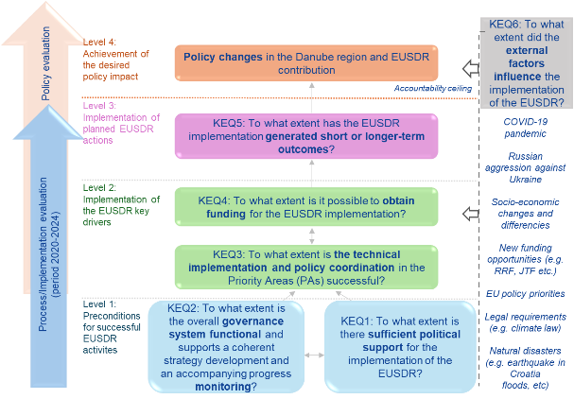
EUSDR Process/Implementation Evaluation
Evaluation topics: political commitment, governance, technical implementation and policy coordination, funding, policy impact, external factors
External evaluator: M&E Factory
Data collection conducted in Summer 2024 – THANK YOU to all core stakeholders who contributed
Final Evaluation Report available on the EUSDR website

Slide 14
EUSDR Process/Implementation Evaluation
Key recommendations
Political commitment:
Increase EU political engagement by involving additional stakeholders (e.g., DG ENEST, line DGs, European Parliament and others) and securing greater commitment on EU and national levels.
Promote the benefits of macro-regional cooperation through national coordination platforms, an EUSDR impact model and clear, targeted messaging for policymakers.
Ensure flexibility in the EUSDR Action Plan to remain adaptable to evolving challenges and opportunities, particularly in the post-2027 EU Cohesion Policy framework.
Governance:
Simplify the EUSDR Governance Architecture to enhance stakeholder understanding and better illustrate the linkages between stakeholders.
Enhance SGs engagement through better information sharing, coordination via national coordination and PA platforms, and capacity-building. Recognise SG contributions through success stories and event presentations to foster a sense of value and encouraging continued involvement.
Strengthen youth involvement by clarifying the Danube Youth Council (DYC) role, tracking its contributions, operationalising the Danube Youth Organisation Network (DYON) with a clear operational plan, and facilitating collaboration between the DYC and the DYON.
Improve monitoring and reporting by aligning with the EUSDR impact model, focusing on both soft and tangible results, streamlining data collection and preparing for potential performance-based reporting in the post-2027 programming period.

Slide 15
EUSDR Process/Implementation Evaluation
Key recommendations
Technical implementation and policy coordination:
Maintain a strategic focus beyond project implementation by developing an EUSDR impact model, adopting mission-oriented approaches that connect individual projects to larger EUSDR´s objectives, and building capacity to translate the EUSDR Action Plan into concrete actions and projects.
Expand stakeholder engagement on EU and national levels, strengthening communication between line DGs and EUSDR core stakeholders (especially PACs), encouraging participation in EC events, and regularly involving regional/local actors in EUSDR activities.
Strengthening information sharing and collaboration across macro-regional strategies (MRS).
Increase the visibility and communication of EUSDR by sharing success stories in EU/national events, targeted communication events (e.g., sector or stakeholder-specific events), engaging in EU enlargement initiatives, and collaborating with civil society and academia.
External factors:
Use the PCY agenda as a "reality check" tool to regularly review and adapt the EUSDR Action Plan to emerging needs, challenges and opportunities.
Establish ad-hoc (crisis-response) working groups across PAs to develop plans/ protocols for quickly responding to external events (e.g., post-2027 Cohesion Policy changes, Ukraine’s recovery).

Slide 16
EUSDR Process/Implementation Evaluation
Key recommendations
Funding:
Enhance funding access and capacity-building of the EUSDR core stakeholders by providing targeted support.
Embed EUSDR into the post-2027 EU Cohesion Policy, positioning it as a key capitalisation tool that scales national project results and translate EU policies into impactful regional actions.
Align the EUSDR embedding tools and activities with the post-2027 Cohesion Policy framework, the Growth Plan for the Western Balkans, and future EU enlargement scenarios.
Address misalignment between EUSDR core stakeholders and various EU-funded programmes by promoting EUSDR as a platform for capitalising on programme results, supporting territorial cohesion, and fostering dialogue between Interreg and mainstream programmes. Clear objectives and project proposals should be formulated to align with funding programmes.
Enhance coordination and synergy across MRS to maximize impact and avoid duplication.

Slide 17

Danube Strategy Flagships
List of Danube Strategy Flagships 2024 published on EUSDR Website
Total of 26 Danube Strategy Flagships
15 new Danube Strategy Flagships
11 updated Danube Strategy Flagships
Selection of Danube Strategy Flagships 2025
Selection phase from March – June 2025 (during the SG meetings of the 1st half-year)
Certificates and promotion/dissemination/exploitation from August 2025 on
Guidance Paper for identifying and listing Danube Strategy Flagships
https://danube-region.eu/projects-and-funding/eusdr-strategic-projects/
Notes:
Strengthen internal and external communication of the Strategy and the visibility of the topics, initiatives and prospects in the Danube Region.
Illustrate the progress achieved in implementing the EUSDR and demonstrate exemplarily significant improvement in the Region that is induced by cooperation.
Strengthening a sector or branch, generating value chains or model solutions to important common challenges faced within the Danube Region.

Slide 18
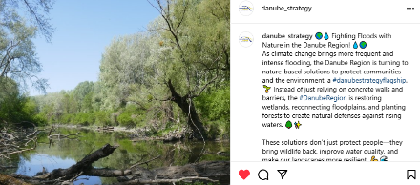
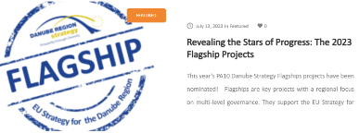
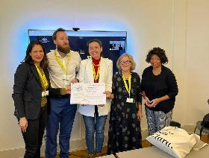
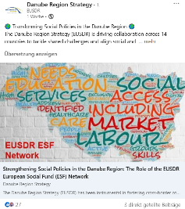
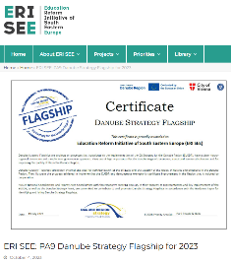
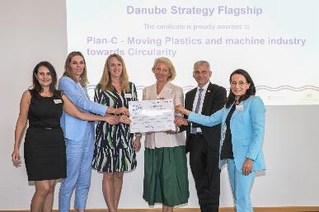
Danube Strategy Flagships - Promotion
Promotion through Certificate Ceremonies
Promotion by EUSDR PAs (e.g., on PA Websites) or by project partners
Promotion on EUSDR Social Media Channels
(LinkedIn, Instagram, Facebook, X, Bluesky)

Slide 19

Communication
Social media platforms constantly updated on LinkedIn, Facebook, X, Instagram, BlueSky)
Social media campaign to promote Flagships on social media channels managed by DSP (started 15 October 2024)
Align communication activities with the EUSDR PCIES for more visibility (promoting events through posts on social media and articles on the main EUSDR website, on the dedicated sub-page)
Disseminating articles on DG Regio’s website for more visibility
Relaunch of the EUSDR website (including 12 PA sites) – summer 2025
Notes:
Ensuring internal and external communication using a mix of measures and channels
EUSDR Website & Intranet
!!! New website goes live 14 Apr 2025
Disseminating articles on DG Regio’s website for more visibility
Ensuring cross-promotions with PAs & other MRS
Testing until 20 June, fixing issues after.

Slide 20

Capacity Building
Planning and implementing capacity building measures
Capacity building Needs Analysis
Capacity building sessions for EUSDR stakeholders
Support EUSDR stakeholders in developing skills for implementing the Strategy
“Unfolding EUSDR” session – EUSDR PCY, NCs, PACs, SG – upon request

Slide 21

Capacity Building
Five training sessions will be provided for EUSDR core stakeholders (NCs, PACs, and SGs) :
Onboarding and Institutional Memory Consolidation – 23.09.2025, Brussels
Policy Analysis and Advocacy Skills – 07.11.2025, Sarajevo
Effective Communication, Collaboration, Consensus-Building and Negotiation Skills – 2026
Strategic Planning for EUSDR Objectives – 2027
Leadership and Self-Leadership – 2028
As a horizontal theme, “Cross-Cultural Administrative Contexts” will be the basis on which all training will be built in terms of structure and content.
Max. 40 participants (per training session) – NCs, PACs, and SGs members (first-come-first-serve basis).
Notes:
1. Onboarding and Institutional Memory Consolidation – 23.09.2025, Brussels before the MR&SBS Days 24 – 25 September
2. Policy Analysis and Advocacy Skills - 07.11.2025, Sarajevo – after AF
S-T-D message sent

Slide 22
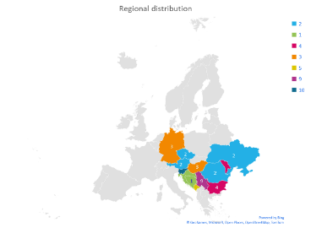
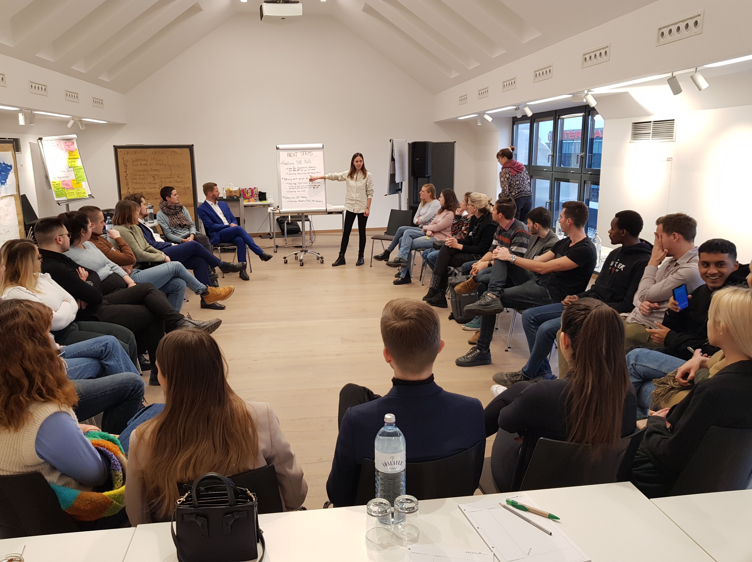
DYC current developments
18 experienced DYC members remained for one more year; 10 new members were appointed.
New members choosen Pas - PA 7 – Anja Filipovič, Sára Herianová, and Felix Häring
Meetings between PAs and (new) DYC members – February – March 2025
4th Danube Youth Camp – 15 – 17 June 2025, Vienna, Austria
DYON current developments
Open network / 49 Youth Organisations
Strategic planning workshop, held online on 17 March 2025
DYON Boot Camp, July 2025
Participation in a youth panel organised by PA 10 as part of the 14th EUSDR Annual Forum / Danube Participation Day (tbc)
Identification of possible EU funding sources for future activities
Notes:
Strategic planning workshop, held online on 17 March 2025:
Delivered by Re-Act, one of the organisations inside DYON, to the other members
Focused on strategic planning of DYON activities for the next 6-12 months
summary to be sent out after the NC meeting
DYON Boot Camp, July 2025:
Currently in the planning phase
Clearer elaboration of DYON identity and governance
Production of a short video, possibly to be shown during the 14th EUSDR Annual Forum (tbc)
Participation in a youth panel organised by PA 10 as part of the 14th EUSDR Annual Forum / Danube Participation Day (tbc)
Identification of possible EU funding sources for future activities

Slide 23
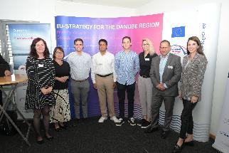
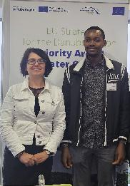
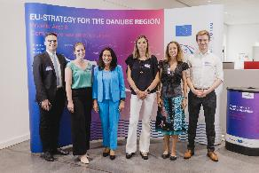
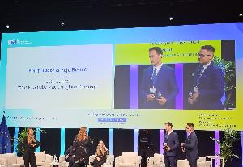
DYC involvement in PAs activities
Contribute / share youth vision on various publications (studies / brochures / surveys / policy papers)
Contribute to projects development
Participation and support in events organisation (SG, conferences, WS) – input on the agendas, organise sessions dedicated to youth
Danube Strategy Flagships selection
Disseminate information within youth networks
on-site participation of minimum one DYC member in one SG meeting per year shall be covered by the PA

Slide 24
Events calendar
EUSDR Management & Governance | Date | Location
4th Danube Youth Camp | 15-17 June 2025 | Vienna, AT
NC-PAC Meeting (+TRIO Presidency Meeting) | 10-11 September 2025 | Sarajevo, BA
10th 4 MRS TRIO PCIES Meeting | 26 September 2025 | Brussels, BE
17th HLG Meeting | 26 September 2025 | Brussels, BE
14th EUSDR Annual Forum | 5-6 November 2025 | Sarajevo, BA
EUSDR MA/Programming authorities Network meeting |  | online
Joint EUSDR NC PAC and EUSAIR Governing Board Meeting | autumn 2025 | Sarajevo, BA
Priority Area & cross-PA/MRS relevant events | Date | Location
Advancing Connectivity, Interoperability, and Resilience of the Danube Region Railway Network | 5 June 2025 | Sarajevo, BA
Workshop on Utilisation of Sewage Sludge in the Danube Region | 20 June 2025 | online
CIPRA Conference “FutureForum Alps 2025 – H20: precious, powerful, scarce” | 27-28 June 2025 | Schaan, LI
3rd International Conference on Sustainability in Hydropower | 2-5 September 2025 | Vienna, AT
10th Mediterranean Coast and Macro-Regional Strategies Week | 15-18 September 2025 | Izola, SI
Macro-Regional and Sea Basin Strategies Days 2025 | 24-25 September 2025 | Brussels, BE
IRE Salzburg Summit | 28-30 September 2025 | Salzburg, AT
Energy - regional interconnections development, optimisation of the renewable sources of energy, regional market, storing, implementation of the ETS system and CBAM | September 2025 | Sarajevo, BA
Implementation of the UN SDGs in Danube Region | October 2025 | Banja Luka (TBC), BA
16th EUSBSR Annual Forum | 28-30 October 2025 | Gdansk, PL
12th Danube Participation Day | 4 November 2025 | Sarajevo, Ba
Meeting of the Danube Transfer Centre Network | 4 November 2025 | Sarajevo, BA
Digitalisation – A Boost for Competitiveness, Efficiency and Sustainability | 5-6 November 2025 | Sarajevo, BA
Danube Rectors’ Conference (DRC) | 12-14 November 2025 | Tuzla, BA
10th EUSALP Annual Forum | 25-26 November 2025 | Innsbruck, AT
SEE2030 Conference with academia on inclusive economic growth (RCC) | November 2025 | Sarajevo, BA
SEE Regional Network of Insurance Sector (focus on disaster insurance coverage) | second half of 2025
SG meetings | Date | Location
PA 4 | 3-4 June 2025 | Bratislava, SK
PA 1b | 4 June 2025 | Sarajevo, BA
PA 7 | 6 June 2025 | Bratislava, SK
PA 9 | 25 June 2025 | online
PA 1b | September 2025 | Izola, SI
PA 3 | 3 November 2025 | Sarajevo, BA
PA 1a | 5 November 2025 | Vienna, AT
PA 8 | 5-6 November 2025 | Sarajevo, BA
PA 9 | 6 - 7 November 2025 | Sarajevo, BA
PA 11 | 19 November 2025 | Sofia, BG
https://danube-region.eu/communication/events

Slide 25
DSP Team

