Slide 1

PA7 WG Higher Education and Mobilities
Ivanka Popović

Slide 2
PA7 WG Higher Education and Mobilities
Continued close collaboration with the Danube Rectors’ Conference,
DRC Initiative Fund for early career researchers,
Western Balkan Mobility Scheme,
Continued support of Ukrainian higher education institutions,
MSCA4Ukraine: another 50 scholarships for displaced UA researchers,
The EU Temporary Protection Directive has been prolonged until March 2026.

Slide 3
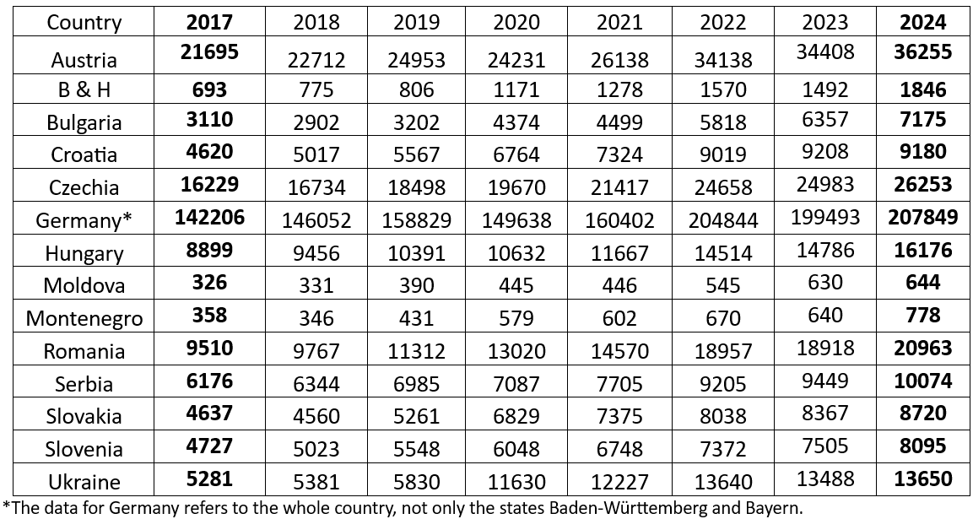
Number of published papers WoS Core Collection

Slide 4
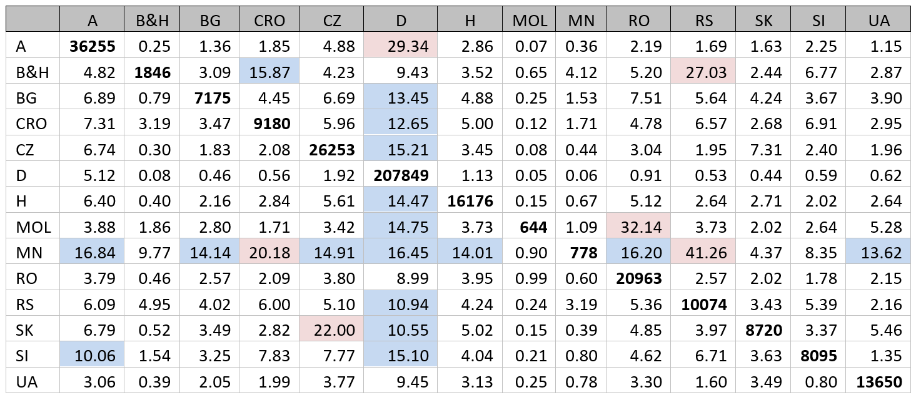
WoS Core Collection 2024

Slide 5
Western Balkans Mobility Scheme POLICY ANSWERS
A total of 31 proposals were received for this call. 22 proposals received funding for a total amount of EUR 101 677.
Country | No. of accepted proposals
Albania | 1
Bosnia & Hercegovina | 4
Kosovo* | 2
Montenegro | 3
Northern Macedonia | 6
Serbia | 6
WBMS_Report.pdf

Slide 6
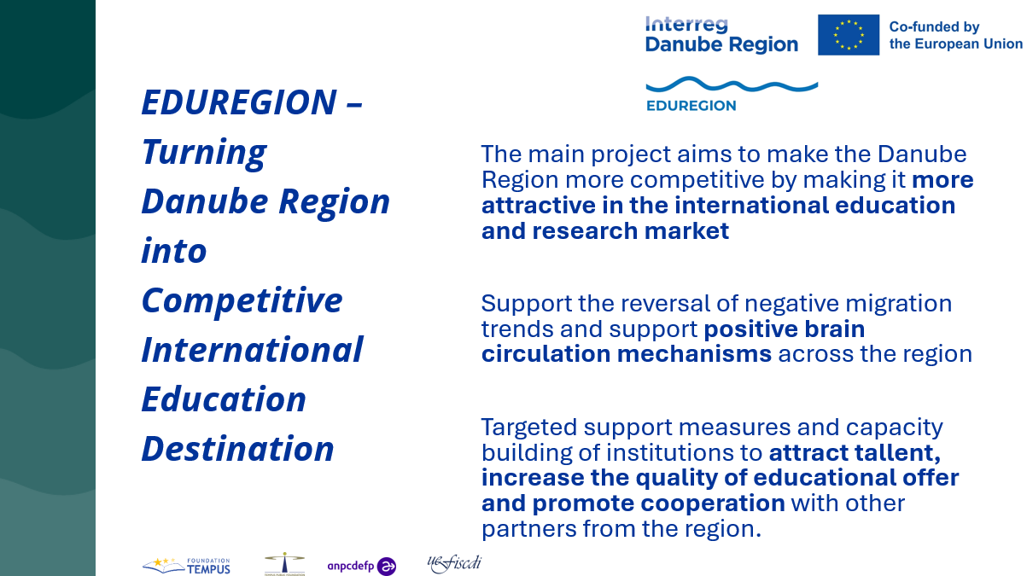
Partners
Tempus Foundations Serbia, Romania and Hungary

Slide 7
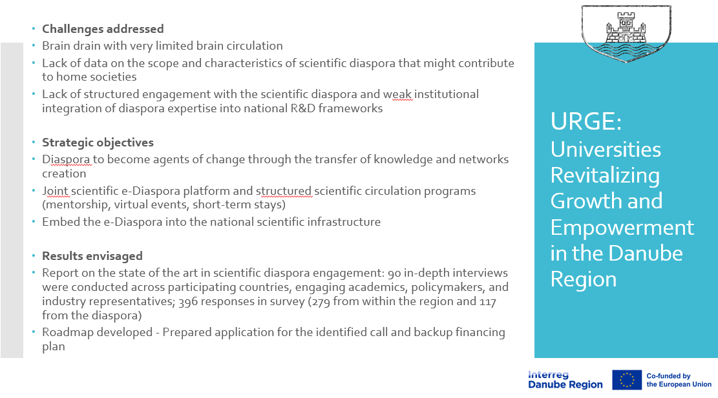
Partners
Universities of Belgrade, Mostar, Montenegro, Ljubljana and Rijeka

Slide 8
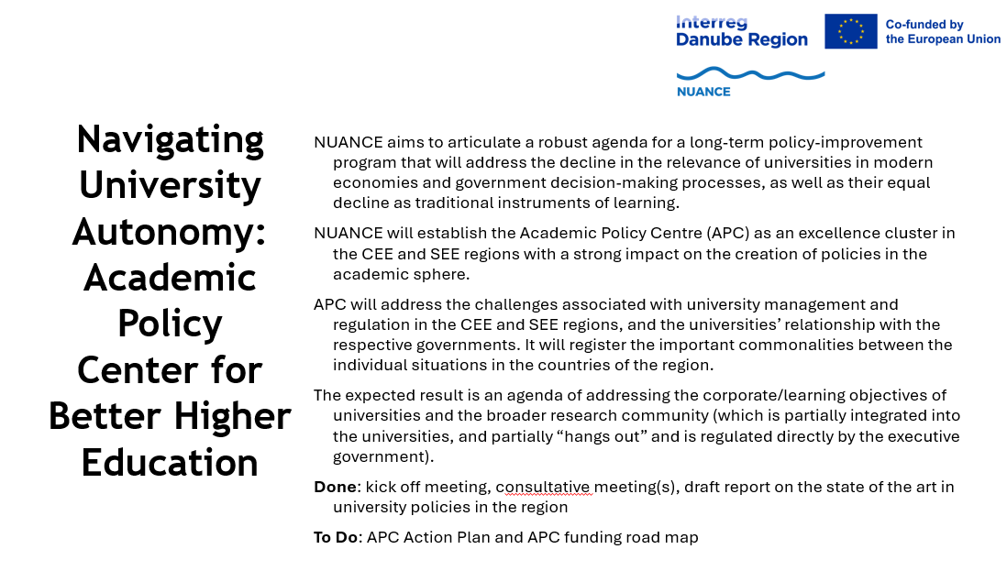
Partners
University of Belgrade – Institute of Philosophy and Social Theory and
Regional Center for Advanced Studies in Humanities Sciences Rijeka

