Slide 1


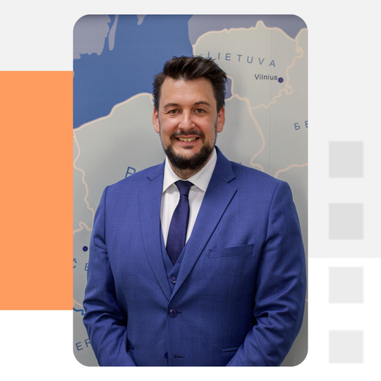




Danubius Young
Scientist Award
Career Tracking
Sebastian Schäffer
29th PA7 Steering Group Meeting
Director
IDM
www.idm.at
@IDMVienna

Slide 2
📊 Danubius Young Scientist Award: Alumni Survey Insights
How does the Danubius Young Scientist Award impact careers? To find out, the IDM surveyed 120 alumni across 14 countries. With a 70% response rate, this study explores key insights on career advancement, the award process, and future improvements.
🎓 120 awardees (2014–2022)
🌍 14 countries
📩 84 responses (70% response rate)
📋 25 survey questions
🗣 8 follow-up interviews
🔗 1st DYSA Alumni Networking Event (Dec 2024)
www.idm.at
@IDMVienna

Slide 3
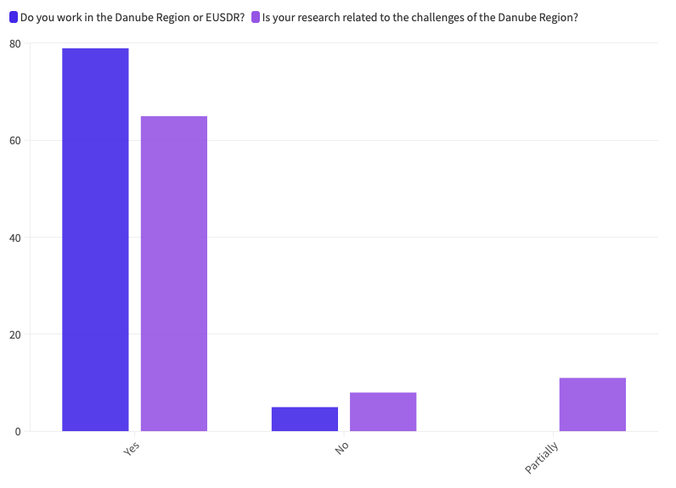
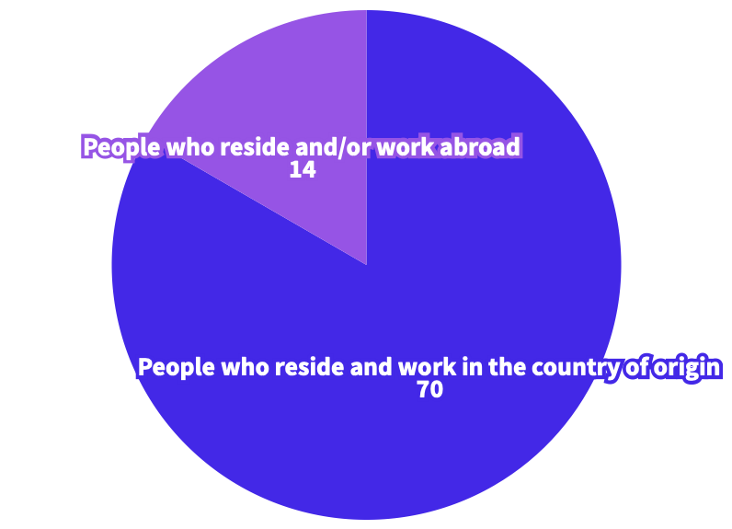

Many alumni stay in the Danube Region...
...and work on topics related to the region.
www.idm.at
@IDMVienna

Slide 4
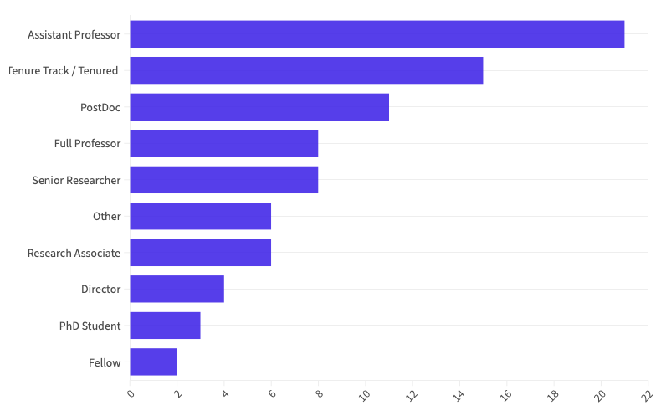

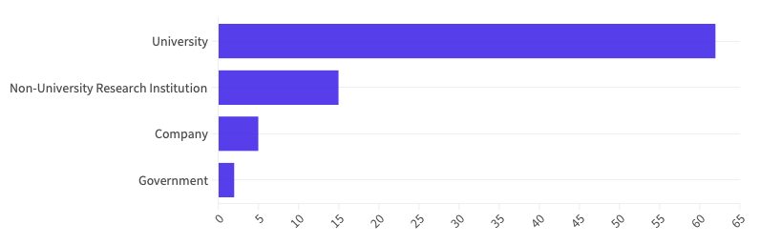

51%
of alumni advanced in their careers after receiving the Award
...in the following positions
57%
of alumni say the Award expanded their professional network
Alumni have great job prospects...
www.idm.at
@IDMVienna

Slide 5
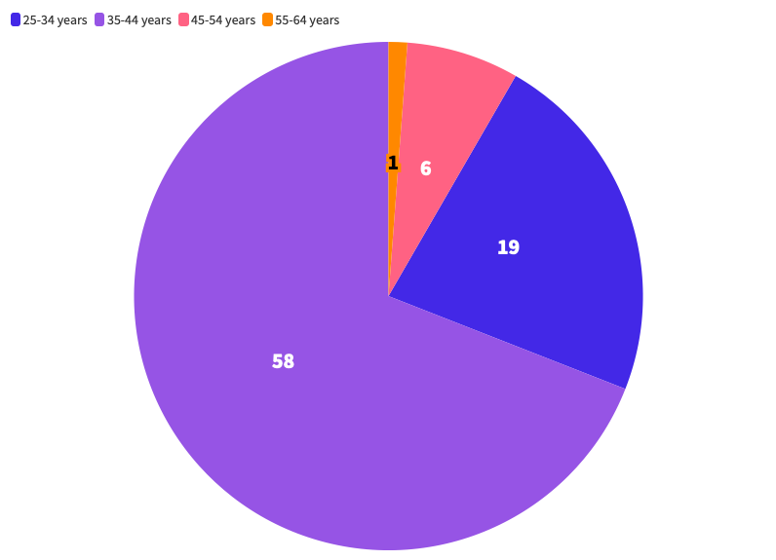
There’s no age limit!
Criteria: The candidate must have received their highest academic degree (Master/PhD) within the last 5 years.
www.idm.at
@IDMVienna

Slide 6
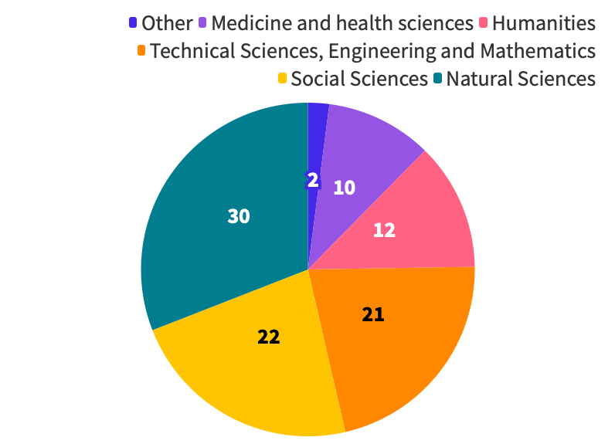
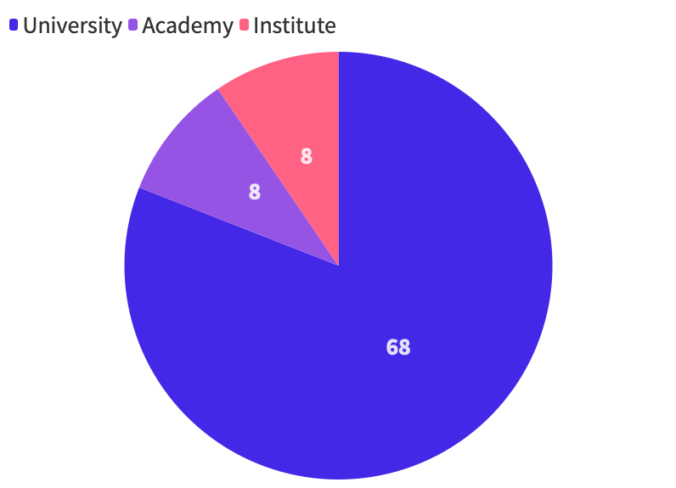



Open to all research fields...
...from diverse academic institutions
www.idm.at
@IDMVienna

Slide 7
kick-start the career of early-stage researchers
Increases visibility
builds professional network
new collaborations
project applications
Contributes to the future of the region
boosts self-confidence
international recognition
stay connected with the Danube Region
opportunities to work abroad
Get promoted
www.idm.at
@IDMVienna

Slide 8
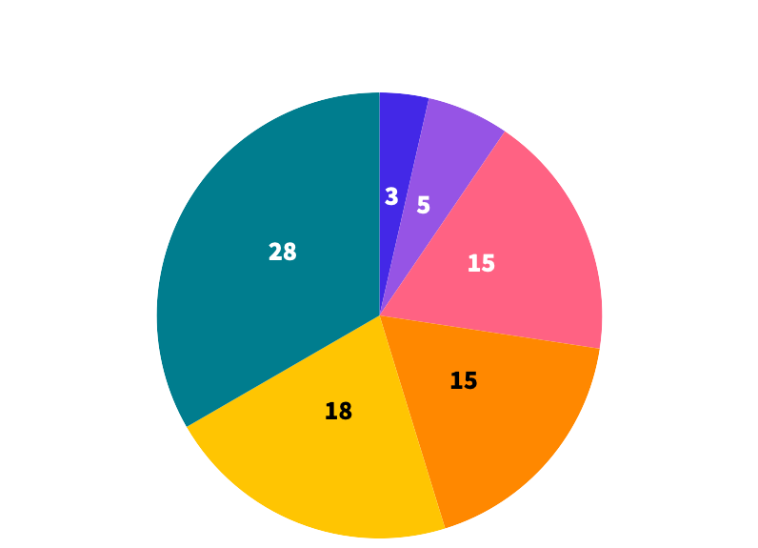

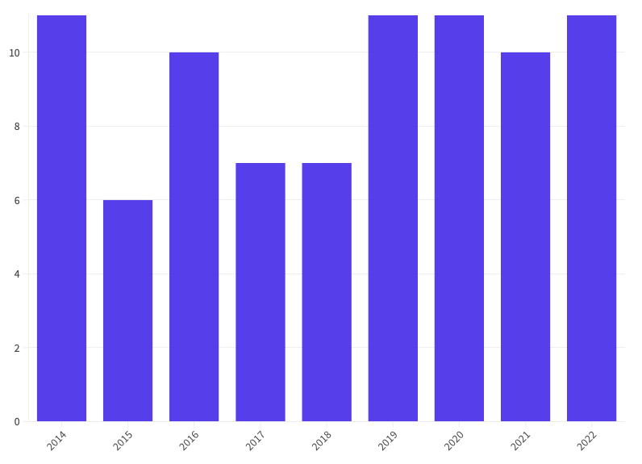
How Our Alumni Found Out About the Award
When Did Survey Participants Receive the Award?
www.idm.at
@IDMVienna

Slide 9
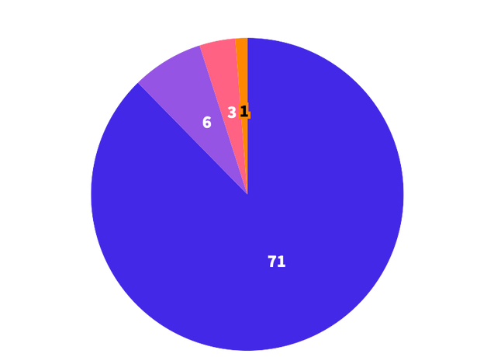
Danubis Award Process: Few Obstacles, But Room for Improvement!
Application & Process Clarity:
Online application form
Clarify selection criteria
Promotion & Outreach:
More publicity at universities
Collaborate with IR departments
Selection Criteria:
Criteria for international cooperation potential
Involve past winners
Focus on the region’s thematic needs
Inclusivity & Fairness:
Multiple nominations from institutions
“Senior” category
Nominations for graduates
www.idm.at
@IDMVienna

Slide 10
The Danubius Award Boosted Confidence to Apply to other Awards - Including...
L’Oréal – UNESCO for Women in Science National Award
Alexander von Humboldt Foundation Scholarship
UNESCO Al-Fozan Award
Young Scientist Award of the Hungarian Academy of Sciences
Fulbright Visiting Scholar Program
Energy Globe Award
Annual Award for Young Scientists “Jasenka Pigac” of the Croatian Microbiological Society
Rada Mihalcea Award
Global Young Academy (GYA)
New York Academy of Science
For all awards, read our full report.
www.idm.at
@IDMVienna

Slide 11
And for a Majority it also Boosted Award Success - Including...
Marie Curie Seal of Excellence
New York Academy of Science
Otto Wichterle Award
Visegrad-Taiwan Fellowship
Start-up World Cup finalist
Richard G. Plaschka-Preis
British Academy Newton International Postdoc Fellowship
Grant for participating in the International Congress of Mathematicians (ICM2018)
Forbes Slovakia 30 under 30
Georg Forster Research Fellowship
For all awards, read our full report.
www.idm.at
@IDMVienna

Slide 12
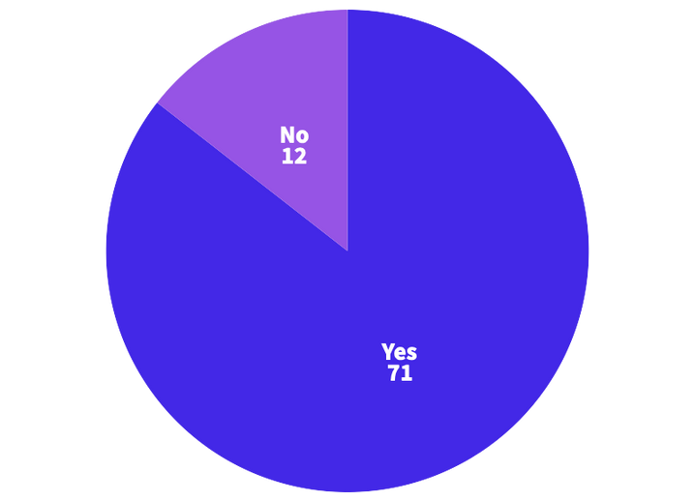
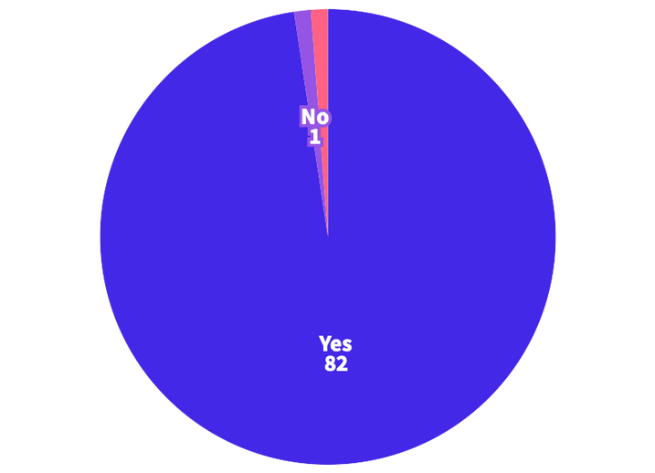
This is How Our Alumni Promoted the Award Through Their own Networks:
CV
LinkedIn
Facebook
Mailing List
Web Pages
TV shows
Local Media
University
Lectures
Colleagues
IR & Project Office
Informal Conversations
Young Scholars
CV, LinkedIn, ResearchGate, Advertising, Research grants, Job & project applications, Greater international credibility
Was the Award Highlighted during Our Alumni’s Career Paths? And How?
www.idm.at
@IDMVienna

Slide 13
...and Some Final Remarks from Our Alumni:
More actions, conferences, workshops with awardees
Have the chance to cooperate with the IDM in the future
DYSA keep going
Great initiative for the region, with a valuable impact for the research community
Award valued more if institutions promoted the process. DRC could be the place for the appreciation of this award and its institutional recognition in the entire Danube Region
Meeting, once a year, with awardees in a different country to meet new scientists and experts
Invite previous awardees who couldn’t go to Ispra due to COVID
www.idm.at
@IDMVienna

