Slide 1




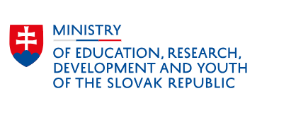

^{Danube Region Strategy}
PA7 Knowledge society WG for ERA
Ľubica Pitlová, PA7 coordinator
6 June 2025 in Bratislava

Slide 2


Activities
Analyses:
Midterm evaluation of the participation of the Danube countries in Horizon Europe
Position Paper:
Reflection on the preparation of the 10th EU Framework Programme for research and innovation from the perspective of the Danube Region
PA7 and PA8 Capitalisation workshop „Boosting Knowledge and Competitivness in the Danube Region:
https://knowledgesociety.danube-region.eu/pa7-pa8-capitalisation-event-in-bratislava-26-27-march-2025/
PA 7 Flagship Projects:
HARMONMISSIONS – renominated
TiCCA4Danu
GeoNetSee

Slide 3
Reflection Paper – Preparation FP10
we acknowledge excellence, green and digital transformation, increasing role of AI, stimulation of public-private cooperation, data-driven economy, and the autonomy, integrity and security of research;
however, geographical location, regulatory environment and market dynamics also play an important role in shaping innovation outcomes

Slide 4
Reflection paper – preparation FP10
continue to support capacity building through Widening calls and/or similar schemes like „Advancing Europe“ ;
allow for ambitious catch-up instruments to align with European R&I standards;
increase the available budget to raise success rates, especially for MSCA and collaborative projects;
maintain continuous support for schemes with geographic approach to build up experience;
support projects with macro-regional focus (e.g. addressing specific ecological, societal and health challenges);
continue support for regional projects focused on specific aspects required for faster integration into the ERA.

Slide 5
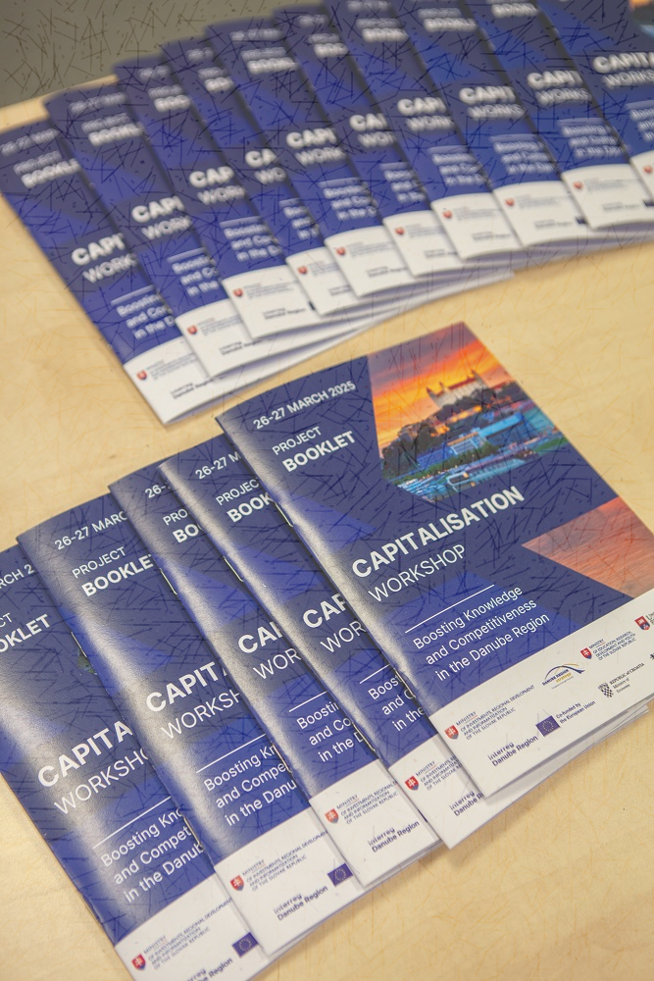
Capitalisation Workshop (I)
22 EU-funded projects from 11 countries of the Danube Region met on 26-27 March 2025 in Bratislava for a Capitalisation workshop – Boosting Knowledge and Competitiveness in the Danube Region on invitation of PA7 Knowledge Society and PA 8 Competitiveness of enterprise
The overall goals:
to inform and learn from each other, form synergies,
make project results better visible and more understandable among various stakeholders,
gain more attention and a wider outreach.
The results of the workshop were clustered in Knowledge Transfer and Reusability, Maximising Impact and Visibility, Policy Influence and Capitalisation and Cooperation and Future Project Opportunities.
More information: https://knowledgesociety.danube-region.eu/pa7-pa8-capitalisation-event-in-bratislava-26-27-march-2025/

Slide 6
Capitalisation Workshop (II)
Day 1 | introductory presentations of projects
Day 2 | discussions divided into 3 focus groups
Circular Economy
Sustainable Cities and Regions
Technology Transfer and Smart Specialisation, and Industry
Main outcomes:
sharing experience and results, exchange of contacts
better visibility of the region through project results
portal of best practices and success stories
EUSDR should facilitate stronger policy support in order to implement project results
capitalisation is important and should continue
WP capitalisation should become a part of project proposals
platform for future cooperation (matchmaking platform to develop new projects)
PA 8 concluding remarks:
Workshop was very useful!
Great overview over subjects and objectives of projects
Very fruitful exchange in 3 focus groups
Many synergies and common challenges identified

Slide 7
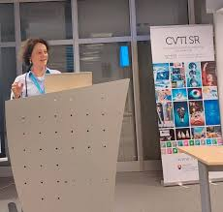
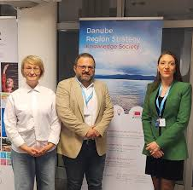
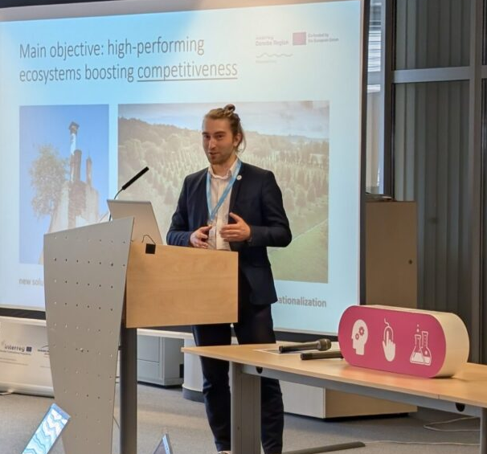
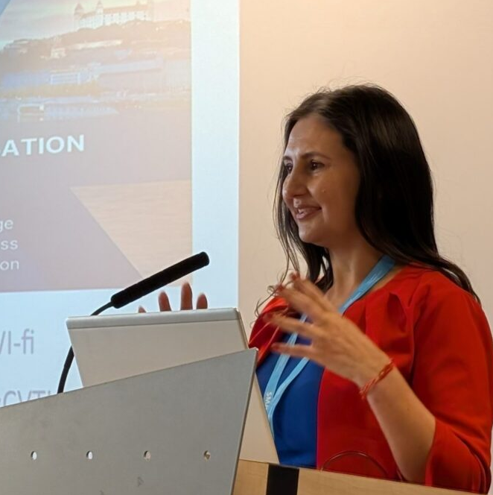
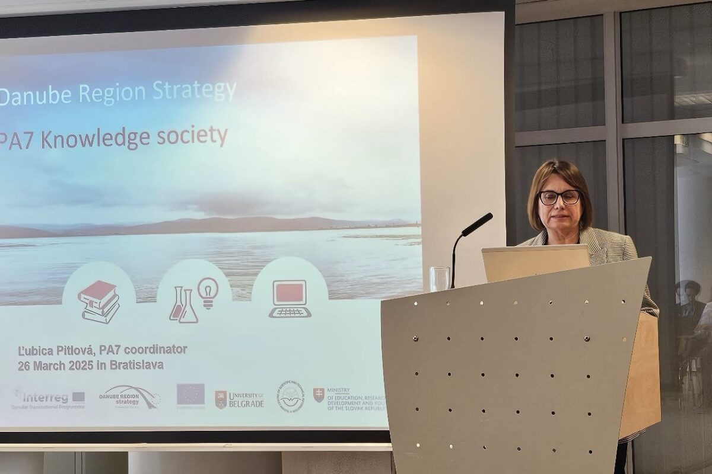
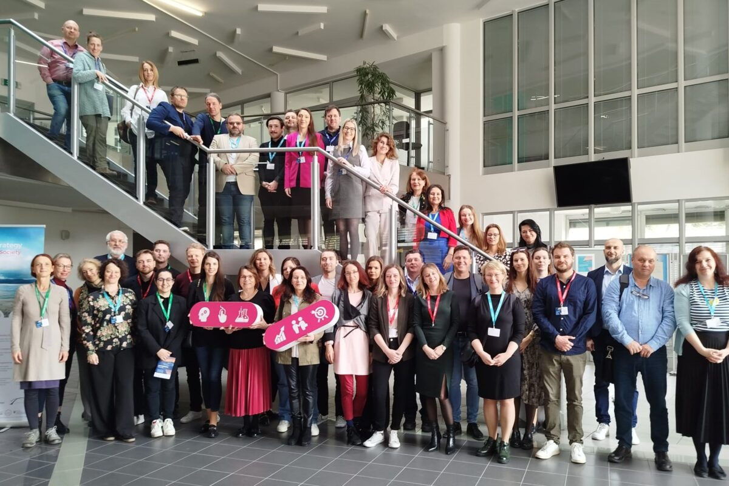
Detailed Summary of the Workshop Conclusions
Knowledge Transfer and Reusability
Supporting and promoting local sustainability initiatives (e.g. local green deal)
Using agile piloting as a universal method for implementing innovative solutions
Organising events to ensure continuity and impact of project outcomes
Facilitating long-term knowledge exchange among stakeholders
EUSDR support: connection to the policy makers, providing an overview of the events in the region
Maximising Impact and Visibility
Hosting online knowledge-sharing sessions for broader outreach
Enhancing collaboration through shared promotional efforts
Danube Strategy Flagship Status
Contributing to shared publications for greater dissemination
Joint projects events
Using EUSDR network and dissemination channels
Youth involvement potentially through youth camps, working groups (universities support)
Policy Influence and Capitalisation in the Region
Capitalisation workshops
Projects advocacy at policy makers level
Leveraging EUSDR Presidencies (including by joint / side events)
Involving projects funded by other programmes
Joint policy briefs of several projects at the end of programme period
Inviting projects to events of the PAs to and then sharing the project results
Focus on in-person events
Repository of the results of DRP projects
Project level impact assessment
Cooperation and Future Project Opportunities
Projects and partners matchmaking events / projects lab (online or in person)
Creating an open contact database / platforms
Agile piloting transfer to other countries and /or complementary upscaling programme
Potential idea: Mitigating the lack of knowledge in the region/enhancing human capital
Potential idea: enhancing R&I ecosystem with various toolboxes
Notes:
2. Event in Brno, potentially aligned with the "Year of the Danube Region" in 2026 or 2027

Slide 8
Online meeting with the SMF projects
PA7 participated at the Stakeholders Event organized by the SMF project ForeDanube | 23 January 2025
Foresight for Danube Region's future-oriented Competitive Planning
research and education on foresight activities in the Danube region
fostering cooperation and knowledge exchange between SMEs, creative industry, academia, the public sector, and civil society
enhancing the application of AI technologies in the Danube Region
improving the framework conditions, support programs, and capacity building of stakeholders to enhance the collaboration between cluster initiatives and regional innovation strategies, with an accent on rural areas.
Networking online event organized by DRP
20 March 2025 | half a year since the implementation of the SMF projects started
SMF lead partners presented their projects
more personal contacts and cooperations were established
common expectations were presented and three introductory presentations were received and discussed with WG HEM and future common meeting is being planned for autumn

Slide 9

PA7 team supports COST Action SiDnet
Science in Diplomacy Network: implementing multilateral policymaking in intersectoral cross disciplinary & strategic domains | approved on 19 May 2025
The proposal addresses the need for advancing science diplomacy, a multidisciplinary field at the intersection of science, technology, and diplomacy, to tackle pressing global issues and geopolitical challenges.
The main goal: create a network that fosters interdisciplinary, crossectoral and trans-European collaboration among diverse stakeholders, including researchers, policymakers, and industry leaders
4 Working Groups:
WG1, "Diplomacy for Science within technological sovereignty and governance,"
WG2, "Science in Diplomacy for global challenges and sustainability,"
WG3, "Science for Diplomacy via international scientific cooperation in difficult geopolitical contexts,"
WG4, "Communication, Dissemination, Training, and Networking," ensures the widespread impact of the Action through public outreach, training, and effective dissemination of results.
More information: https://www.cost.eu/70-new-cost-actions-oc20241/

Slide 10




For more information
www.danubeknowledgesociety.eu
facebook.com/DanubeKnowledgeSociety
#DanubeKnowledgeSociety
@EUSDR_knowledge

