Slide 1

Challenges and Perspectives of Higher Education in the Danube Region
Ivanka Popović

Slide 2
Challenges
overcoming consequences of the pandemic,
geopolitical tensions,
the war in Ukraine,
optimal utilization of AI,
cybersecurity,
funding cuts,
expectations of FP 10

Slide 3
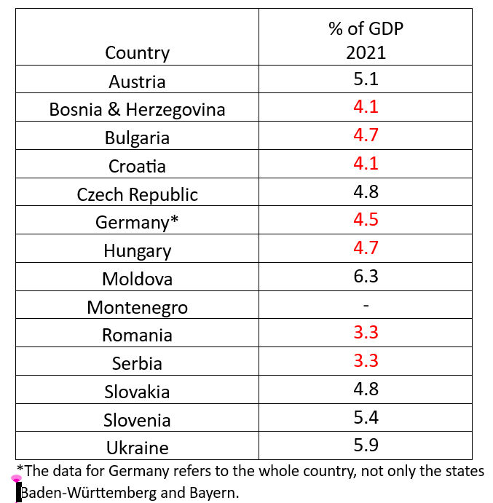
World Bank data on government expenditure on education in 2021
EU average
4.8%

Slide 4
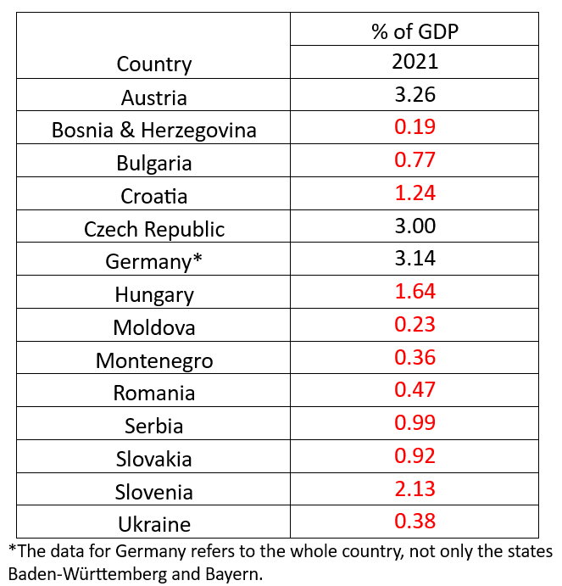
World Bank data on research and development expenditures in 2021
EU average
2.27%

Slide 5
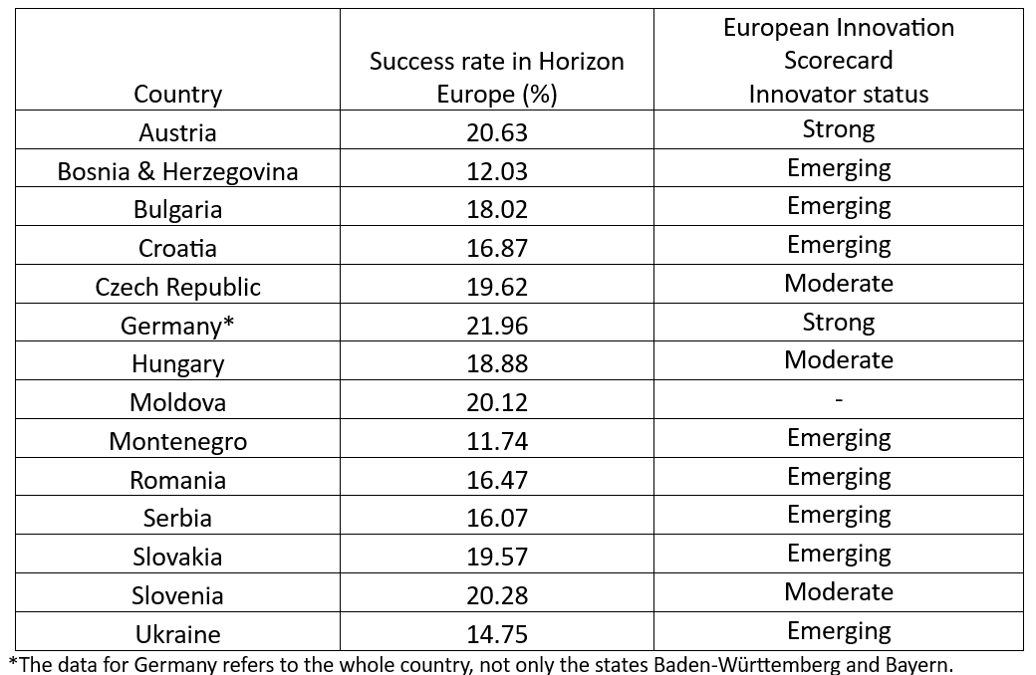
R & I Potential of the Danube Region

Slide 6
European Universities Initiative
65 European Universities alliances,
More than 570 higher education institutions across all EU Member States, Iceland, Norway, Serbia and Turkey,
Driver of academic progress or the start of a two-tier academic community?

Slide 7
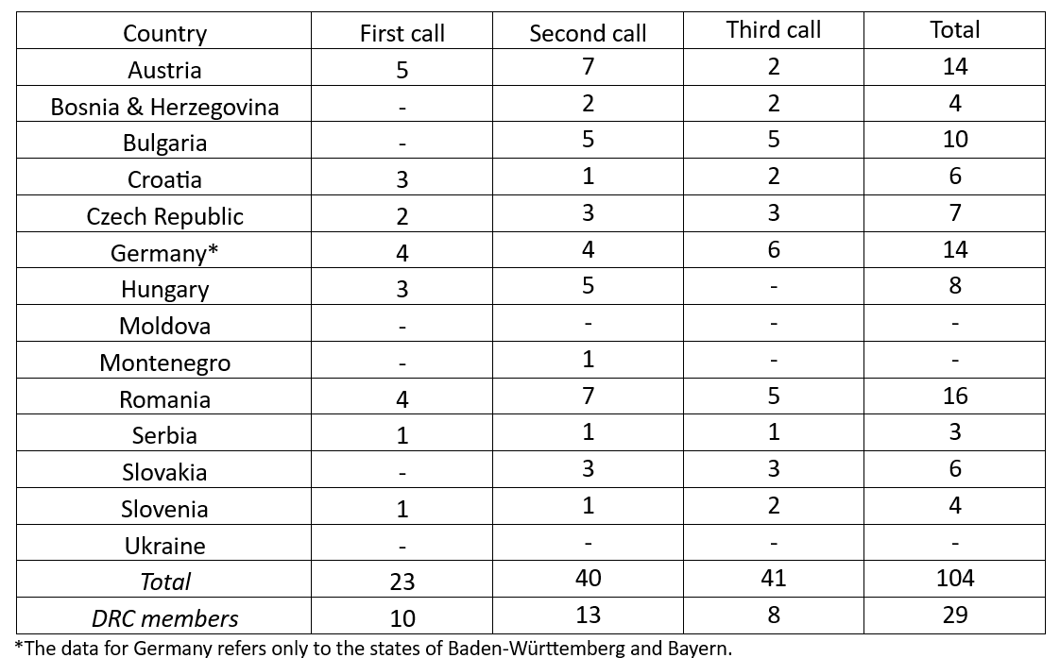
Universities that are members of a European University Alliance

Slide 8
Is the mission of universities being challenged?
Universities as drivers of progress
Universities as drivers of social change
Universities as safe spaces for open debate and critical thinking
Universities as promoters of European values

Slide 9
European values and university autonomy
European values emphasize individual rights and freedoms, democratic principles, and a commitment to the rule of law, justice and solidarity within a society that values pluralism, tolerance and non-discrimination.

Slide 10

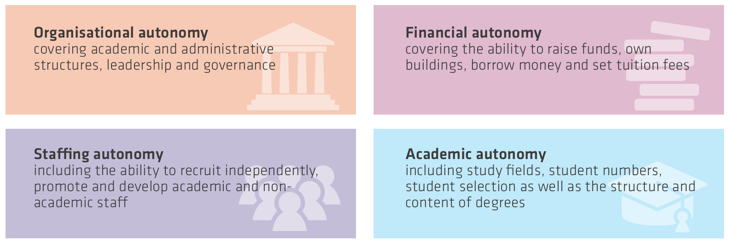
Autonomy Scorecard
University Autonomy in Europe IV: The Scorecard 2023

Slide 11
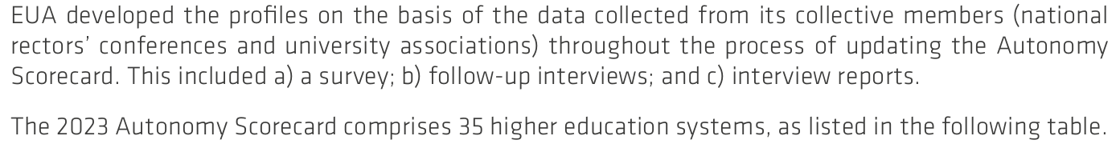
Note: Germany was not analysed as a whole. There are reports about Brandenburg, Hessen and North Rhine-Wastphalia.

Slide 12
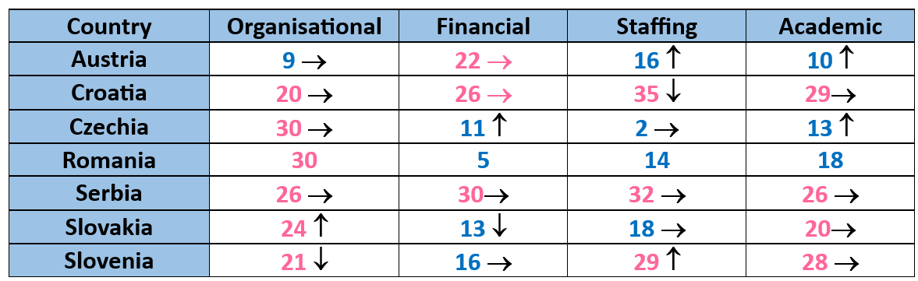
Autonomy Scorecard – 2023 Ranking
Hungary is not featured in the 2023 edition of the Autonomy Scorecard. The foundation university governance model has unique characteristics and far-reaching consequences in the different autonomy dimensions, which cannot be adequately captured by the Scorecard methodology.

Slide 13
Universities as cataysts
Throughout history, universities have played a key role in addressing major crises. They have done so by making important contributions to cross-cultural understanding, social transformation, evidence-based policy making and informed debates.
Europe’s universities are catalysts for social transformation

Slide 14
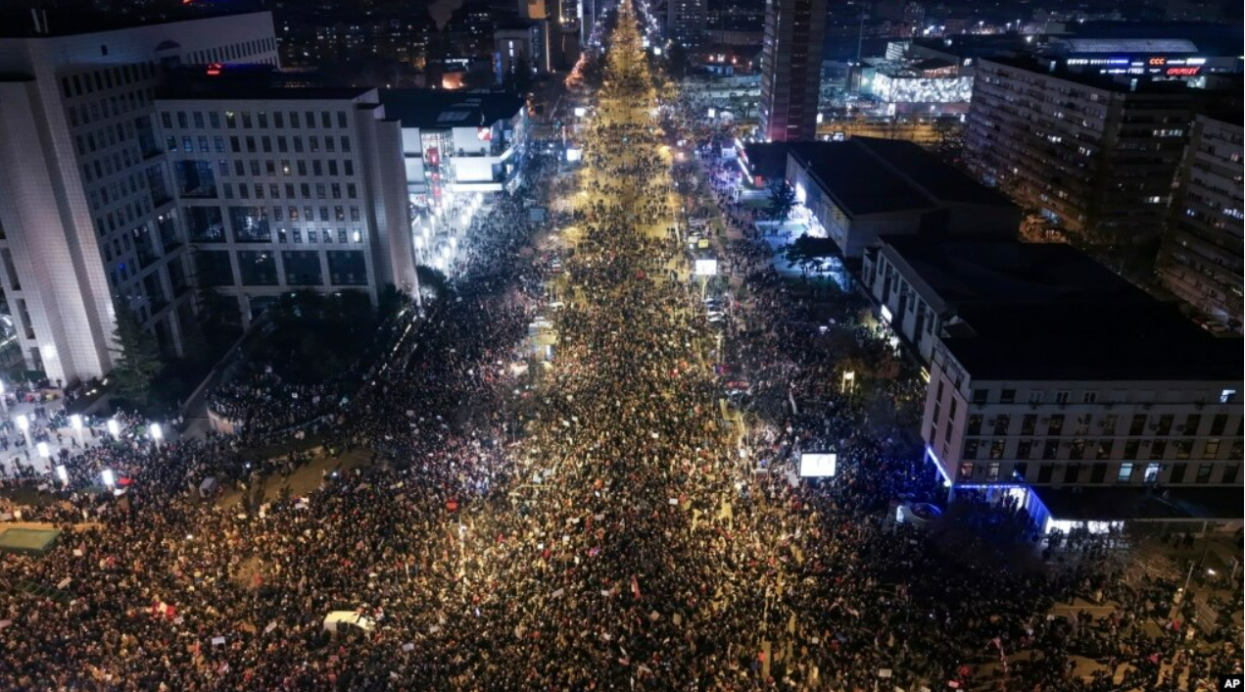
Student - led protests in Serbia

