Slide 1


Measuring the knowledge society: indicators and insights from the Danube Region
Dijana Štrbac, PhD
Research Associate
Institute of Economic Sciences, Belgrade
Slovak Centre of Scientific and Technical Information, Bratislava, 6 June 2025

Slide 2
Concept and characteristics of the knowledge society
“Knowledge societies are about capabilities to identify, produce, process, transform, disseminate and use information to build and apply knowledge for human development.” (UNESCO, 2005)
“The term knowledge society refers to a society in which the creation, dissemination, and utilization of information and knowledge has become the most important factor of production. In such a society, knowledge assets (also called intellectual capital) are the most powerful producer of wealth, sidelining the importance of land, the volume of labor, and physical or financial capital.” (International Encyclopedia of the Social Sciences, 2008)
Key features:
Central role of knowledge
High-quality education and lifelong learning
Research, innovation and creativity
Information and communication technologies (ICT)
Open access to information and transparency
Interdisciplinary and collaborative approach
Inclusive and participatory society
Knowledge-based economy

Slide 3
Pillars of the knowledge society
Education and Human Capital
Research and innovation
Digital and ICT Readiness
Knowledge-Based Economy
Inclusiveness and Governance

Slide 4
EDUCATION AND HUMAN CAPITAL
Students in tertiary education - as % of 20-24 years old in the
population

Slide 5
Lifelong learning participation (formal and non-formal education and training - % of population aged 25–64)
Source: Eurostat

Slide 6
Early leavers from education and training (% of population from 18 to 24 years)

Slide 7
RESEARCH AND INNOVATION
Gross domestic expenditure on R&D (GERD, % of GDP)

Slide 8
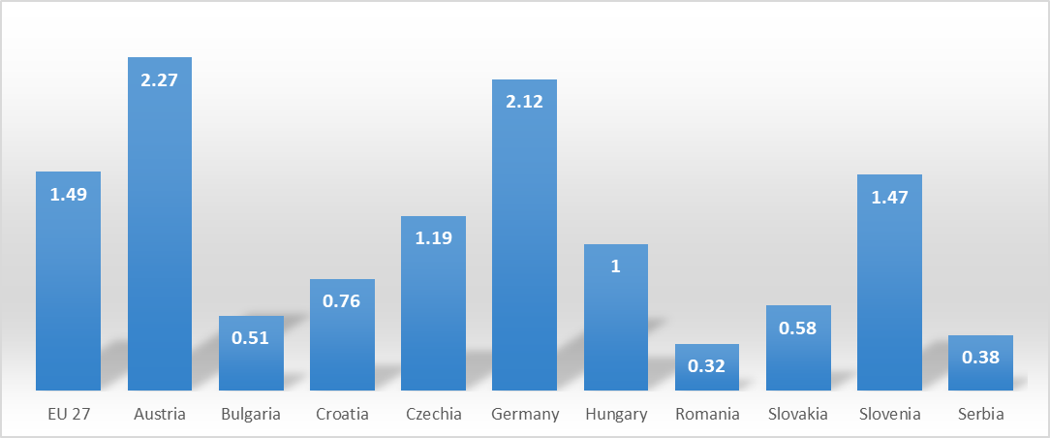
Business enterprise R&D expenditure (BERD, % of GDP) in 2023.

Slide 9
Researchers FTE (per million inhabitants)

Slide 10
Patent resident applications per million inhabitants in 2023.

Slide 11
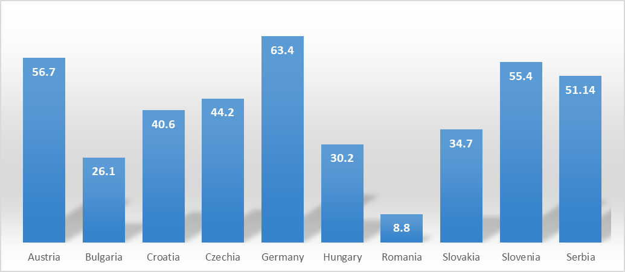
Innovation active enterprises (%) – CIS 2020-2022

Slide 12
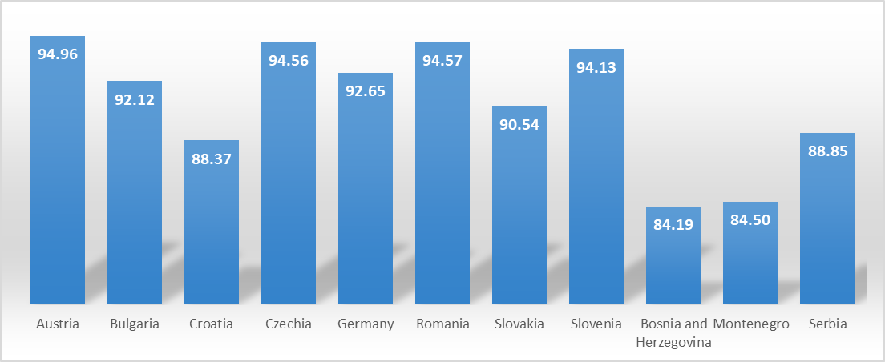
DIGITAL AND ICT READINESS
Households with internet access in 2024 (%)

Slide 13
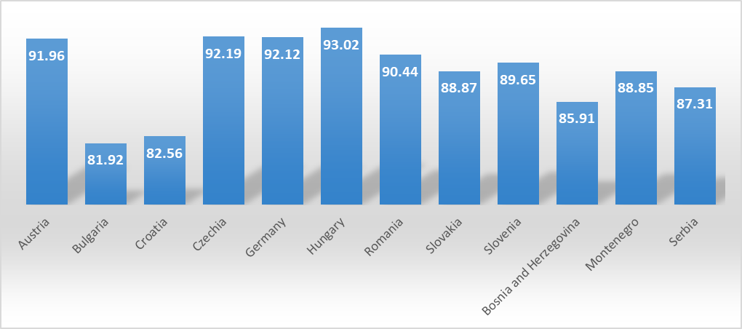
Individuals using the internet regularly (%) in 2024

Slide 14
ICT specialists (% of total employment)

Slide 15
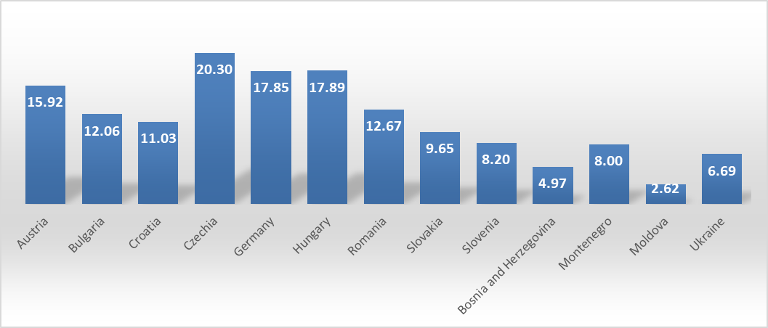
KNOWLEDGE-BASED ECONOMY
High-technology exports (% of manufactured exports) in 2023

Slide 16
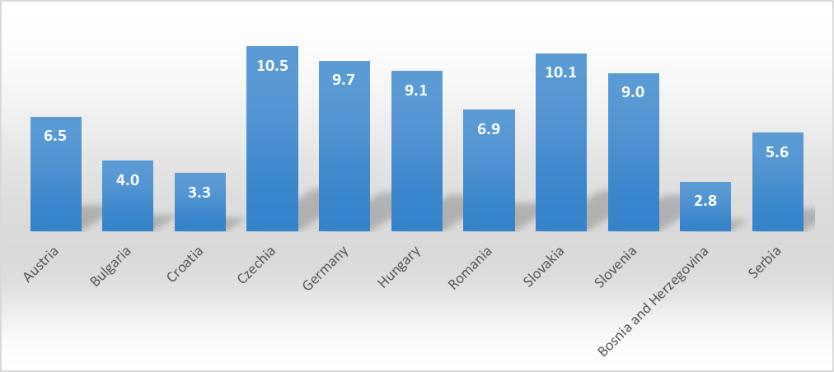
Employment in high- and medium-high technology manufacturing sectors (% of total employment) in 2024

Slide 17
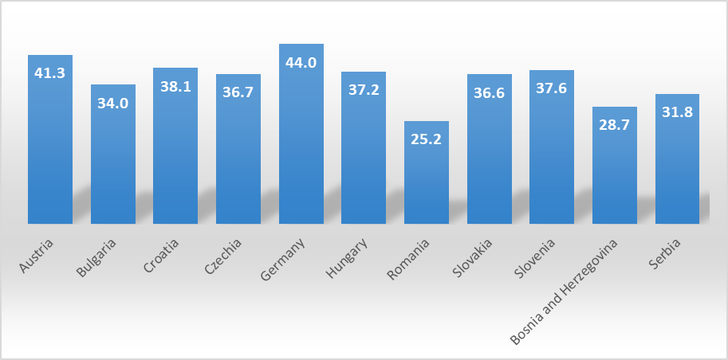
Employment in total knowledge-intensive services (% of total employment) in 2024

Slide 18
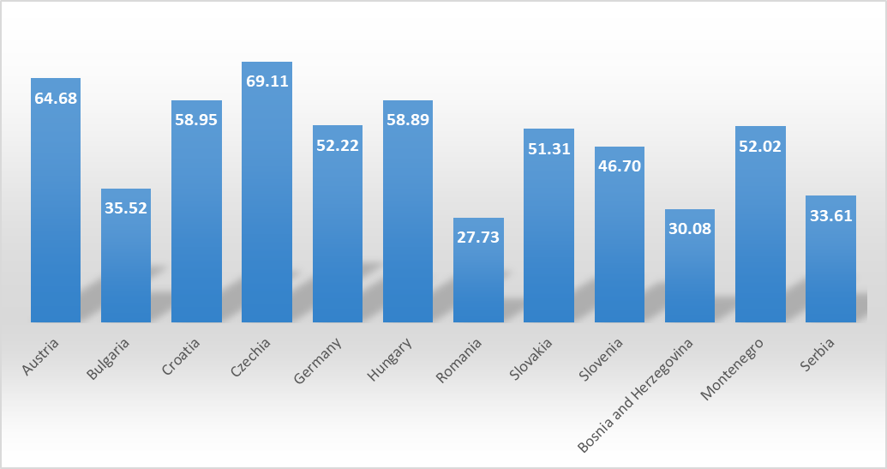
INCLUSIVENESS
Digital skills of population (% with at least basic digital skills) in 2023

Slide 19
Share of female researchers FTE

Slide 20
Conclusions
Progress toward a knowledge society in the Danube region is uneven. Some countries face significant challenges in R&D investment, human capital and innovation impact.
Education and lifelong learning remain key enablers. Higher participation in tertiary education and adult training correlates with better outcomes in innovation and digital economy performance.
Innovation systems need strengthening. Patenting activity and researcher density are still below EU averages in many countries, signalling underutilized R&D capacity.
Digital inclusion gaps persist. The rise in internet access and regular usage is encouraging, but disparities in digital skills and ICT employment point to a digital divide.
Knowledge-based sectors are growing but not yet dominant. Employment in high-tech manufacturing and knowledge-intensive services is increasing but still represents a limited share of total employment in several economies.

Slide 21
Policy recommendations
• Strengthen education and upskilling systems. Invest in modern, inclusive education systems that integrate digital and transversal skills from early on, and expand access to lifelong learning, especially for older and lower-educated adults.
• Boost public and private R&D investments. Create more favorable conditions for business R&D through targeted incentives, streamlined funding mechanisms, and stronger university–industry collaboration.
• Support inclusive digital transformation. Develop comprehensive digital skills strategies to improve access for disadvantaged groups and promote gender equality in STEM and ICT professions.
• Foster innovation ecosystems. Enhance the institutional framework for innovation through better coordination between research, policy, and business sectors — and by scaling up support for startups and SMEs.
• Promote knowledge-intensive economic sectors. Design industrial and innovation policies that prioritize transition toward high- and medium-high-tech manufacturing and services, including green and digital innovations.
• Monitor progress through robust indicators. Institutionalize regular measurement of knowledge society pillars and ensure data-driven policymaking at both national and regional levels.

Slide 22
Thank you for your attention!

