Slide 1






^{Study:}
Unveiling Research Synergies in the Danube Region: Exploring Potential Research Collaboration in the Context of Smart Specialisation
^{Key findings of the study}
Prof. Dr. Viktor Nedović, EUSDR PA7 co-coordinator, Serbia
Dr. Lazar Živković, IEN, Serbia
Dr. Dijana Štrbac, IEN, EUSDR PA7 support team member, Serbia
PA7 Meeting
6. Jun 2025,

Slide 2


Structure od the study
The study has been completed, and the final version is currently undergoing internal review and final revisions before publication
This presentation will provide an overview of the study’s structure, methodology, key findings, and strategic recommendations.
TABLE OF CONTENTS
Introduction
Smart Specialisation Strategies in the Danube Region
Identification of Key Priority Domains in the Danube Region Based on S3 Priority Areas
Unveiling collaboration patterns and networks in the Danube region countries
Key Findings and Policy Recommendations

Slide 3
Smart Specialisation Strategy: Regional Innovation through Collaboration
The S3 approach highlights the unique role of regions in innovation, supporting bottom-up strategies to align investments with local strengths and market opportunities.
Scientific findings indicate that S3 can enhance cross-border cooperation, particularly among regions with complementary capabilities, thereby accelerating innovation and contributing to inclusive economic development (Radošević, 2018; Woolford et al., 2021).
Collaborative R&I efforts help address specific regional issues, such as environmental sustainability, public health, and economic disparities, with contextually relevant solutions.
Regional collaboration builds educational networks, enhances workforce development, and encourages the exchange of best practices and technologies tailored to regional needs.

Slide 4
Aim of the study
This study, based on an analysis of Horizon Europe projects from 2021 to 2024, explores the current state of research collaboration in the Danube Region, identifies key research domains, and provides actionable recommendations for fostering stronger interregional synergies.
Specifically, it addresses the following key questions:
What are the most common priority research areas identified in the Smart Specialisation Strategies of Danube Region countries? By examining these areas, the study aims to highlight thematic strengths and identify opportunities for alignment across borders.
How are the research networks structured in the region, particularly in terms of connectivity, centrality, and collaboration patterns? Social network analysis is used to uncover the dynamics of these networks and to determine the role of key institutions.
What are the emerging subfields in the most common S3 priority areas? The study explores the specific sub-themes driving innovation in these domains.
How can the region foster greater synergy and inclusivity in research collaboration? Based on the findings, the study offers actionable recommendations to address disparities and strengthen the collective research impact of the region.

Slide 5
Identification of Key Priority Domains in the Danube Region Based on S3 Priority Areas
A structured process was conducted to establish shared research priorities across countries:
A comprehensive list of priority research areas was compiled based on the priorities identified by each country.
The frequency of each priority area across countries was analyzed to determine its prevalence.
Similar priority areas were grouped together to identify those shared by multiple countries.
Common priority areas were then ranked according to the number of countries that prioritized them, highlighting the most prevalent research themes in the region.
List compilation
Frequency Analysis
Similar Priority Areas Grouped
Ranking
Step-by-step approach conducted to identify common research priority areas in the Danube Region

Slide 6
The most prioritized domains in the Danube Region
Agri-Food, Bioeconomy & Biotechnology
Covers sustainable agriculture, food security, and bioeconomy to support rural development and environmental sustainability.
ICT and Digitalisation
Encompasses Digital Transformation, Industry 4.0, and ICT-enabled green IT products. Focused on enhancing digital skills, connectivity, and automation to drive regional innovation.
Climate and Energy
Includes sustainable energy, renewable resources, and climate resilience. Emphasizes regional efforts to mitigate climate impacts and promote energy efficiency.
These shared priorities create opportunities to address cross-border challenges such as climate change, food security, and public health crises.

Slide 7
Research Participation of the Danube Region countries in Horizon Europe Projects
Horizon Europe participation by country in the Danube Region (2021-2024)
Country Code | Country | Number of participations | Population (in millions) | Participation per million inhabitants
AT | Austria | 2,789 | 9 | 309.89
BG | Bulgaria | 610 | 6.9 | 88.41
HR | Croatia | 522 | 4 | 130.5
CZ | Czech Republic | 1,369 | 10.7 | 127.94
DE | Germany (Bavaria & Baden-Württemberg) | 4,358 | 24.2 | 180.08
HU | Hungary | 781 | 9.6 | 81.35
RO | Romania | 1,067 | 19.1 | 55.87
SK | Slovakia | 422 | 5.4 | 78.15
SI | Slovenia | 1,069 | 2.1 | 509.05
BA | Bosnia and Herzegovina | 51 | 3.3 | 15.45
MD | Moldova | 66 | 2.6 | 25.38
ME | Montenegro | 32 | 0.6 | 53.33
RS | Serbia | 455 | 6.8 | 66.91
UA | Ukraine | 333 | 41.2 | 8.08
Source: CORDIS and Eurostat database

Slide 8
Key research sub-fields in the Danube region
Agri-Food, Bioeconomy & Biotechnology
The Danube region shows strong involvement in agri-food innovation, especially in sustainable agriculture, food security, and value chain development. There is growing attention to bioeconomy through projects on biological resources, circular systems, and bio-based materials.
ICT and Digitalisation:
The most active domain, led by software development (476 projects), reflects strong capacity in software engineering and digital innovation. Artificial Intelligence (401 projects) follows closely, with a focus on machine learning, deep learning, and AI-driven solutions.
Climate and Energy
The focus on recycling, renewable energy, and wastewater management signals a strong alignment with EU sustainability goals and commitment to green innovation.

Slide 9
Collaboration Network Structure in the Danube Region
The Horizon Europe collaboration network in the Danube Region, across all three leading S3 priority areas exhibits a robust and well-organized structure, reflecting strong institutional cooperation.
A key feature is the presence of central hubs - a small number of highly connected organizations that serve as anchors for regional research collaboration.
The geographical distribution of collaboration is uneven:
Germany and Austria lead the network, with several institutions in central and highly influential positions. Their organizations act as gateways connecting the broader region to EU-level research efforts.
In contrast, smaller institutions, especially those from emerging and non-EU countries, often remain at the network periphery, reflecting persistent disparities in access, capacity, and funding.

Slide 10
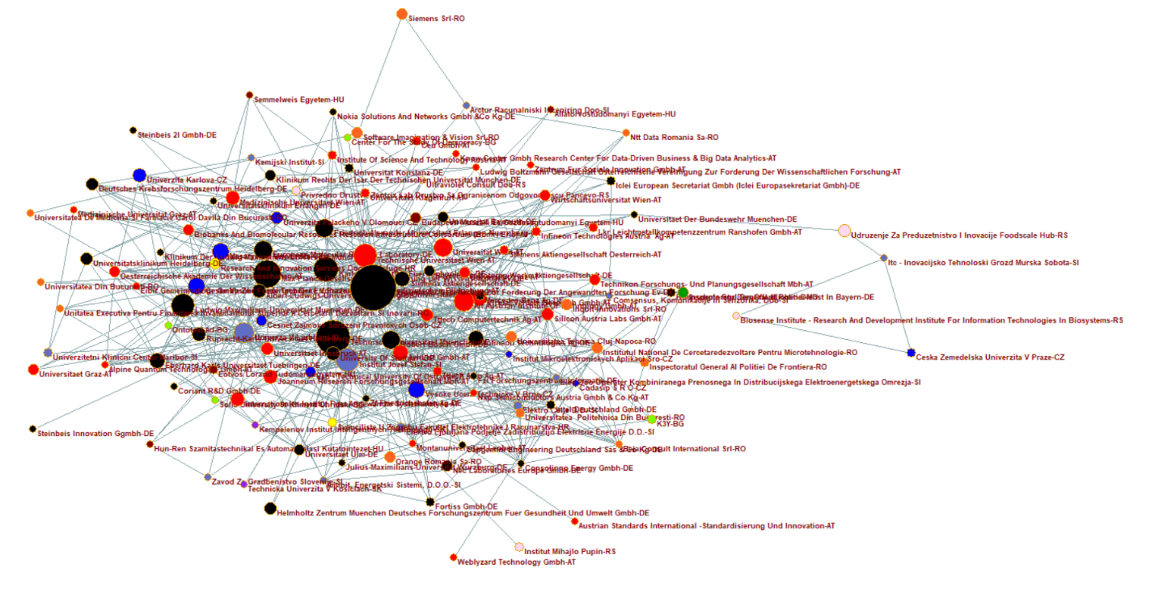
Project Cooperation Network in ICT and Digitalisation Example from one of the leading S3 priority areas
Project cooperation network of the organisations from the Danube region in the area of ICT and Digitalisation in the projects financed under Horizon Europe programme

Slide 11
Key Findings
Horizon Europe participation varies widely across the Danube region.
High-performing countries: Slovenia, Austria, Germany (Bavaria & Baden-Württemberg) – strong integration into EU research funding and mature ecosystems.
Lower-performing countries: Ukraine, Bosnia and Herzegovina, Moldova, Montenegro – face structural barriers to funding and cooperation.
Research intensity is linked to institutional capacity, not country size.
Well-funded and strategically positioned institutions outperform even in small countries.
Three dominant S3 priority areas:
Agri-Food, Bioeconomy & Biotechnology
ICT and Digitalisation
Climate and Energy
These priorities are aligned with the EU Green Deal and Digital Europe strategies.

Slide 12
Key Findings
Horizon Europe networks in the Danube region are highly structured, with a few central institutions:
Core hubs: Fraunhofer Society for the Advancement of Applied Research, Technical University of Munich, Jožef Stefan Institute, Vienna University of Technology, University of Natural Resources and Life Sciences, Vienna.
Emerging players: Institutions from Croatia, and Serbia gaining influence.
Peripheral countries and smaller institutions remain marginal due to:
Funding constraints,
Administrative burdens,
Weak institutional capacity.
Important bridging institutions:
Jožef Stefan Institute and Ruđer Bošković Institute play an important bridging role, connecting smaller institutions to leading research networks

Slide 13
Future Directions for Research Collaboration in the Danube Region
1. Bridge regional disparities: Support non-EU countries (e.g. Ukraine, Moldova, Bosnia and Herzegovina, Montenegro) through targeted capacity-building programs, infrastructure development, and access to EU funding.
2. Promote cross-border & interdisciplinary collaboration: Leverage common S3 priorities through joint initiatives.
3. Empower bridging institutions: Bridging Institutions should act as mentors, training facilitators, and co-creation hubs for smaller institutions across the region

Slide 14
Future Directions for Research Collaboration in the Danube Region
4. Target emerging fields: Prioritize investment in AI, digital twins, hydrogen technologies, and circular economy innovations through public-private partnerships and dedicated funding calls.
5. Leverage regional strengths for mentorship & knowledge sharing: High-capacity countries (Austria, Germany) should support less developed ecosystems via mentorship programs, technical assistance, and joint R&I initiatives on societal challenges
6. Establish more intensive cooperation between EUSDR priority areas and successful project partnerships in the region

Slide 15





For more information
www.danubeknowledgesociety.eu
facebook.com/DanubeKnowledgeSociety
#DanubeKnowledgeSociety
@EUSDR_knowledge

